Slide 1
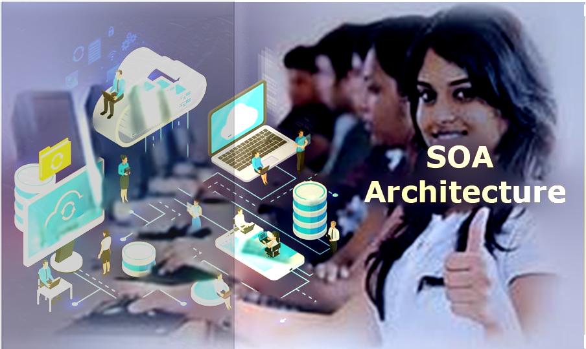
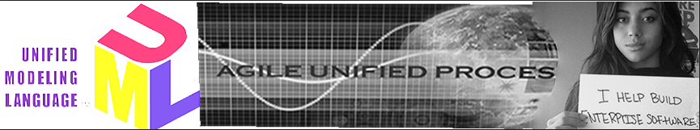
SOA:service-oriented architecture, defines a way to make software components reusable and interoperable via service interfaces. Services use common interface standards and an architectural pattern so they can be rapidly incorporated into new applications.
These services can be built from scratch but are often created by exposing functions from legacy systems of record as service interfaces.

Slide 2
Important Course Links:
Google Docs: Lecture Notes:
https://docs.google.com/document/d/1ZoETXjRLi3kR2LGngMJZX75PB9yyJoOPzwZ9scd1z0Y/edit?usp=sharing
Mindmap:
https://share.mindmanager.com/#publish/vPgwISe2yeF512XLicEx653ExYrnkSITUhfciYc4
Peter’s Dropbox Folder: Unified Process and UML:
https://www.dropbox.com/sh/ua6yppm87wgklz0/AADfgAD8MRw-yfOQk-pFKMrRa?dl=0
Instructional Material on TCPIP Networking:
https://www.dropbox.com/sh/ejy0joisa00ktoi/AAAB5VS307q7o8TiMzOzpIF5a?dl=0
Lexical (Word) Analysis: https://youtu.be/DnCYcvRL9xg
Slack Workspace LINK:
https://join.slack.com/t/petersigurdsongroup/shared_invite/zt-r1bt06s1-SJh44BsGDsMi34XTjSCidw
Course Dropbox LINK:
https://www.dropbox.com/sh/9kxbskr5j5khspq/AACBUWSSXserpRnY7sjUdI1ea?dl=0

Slide 3
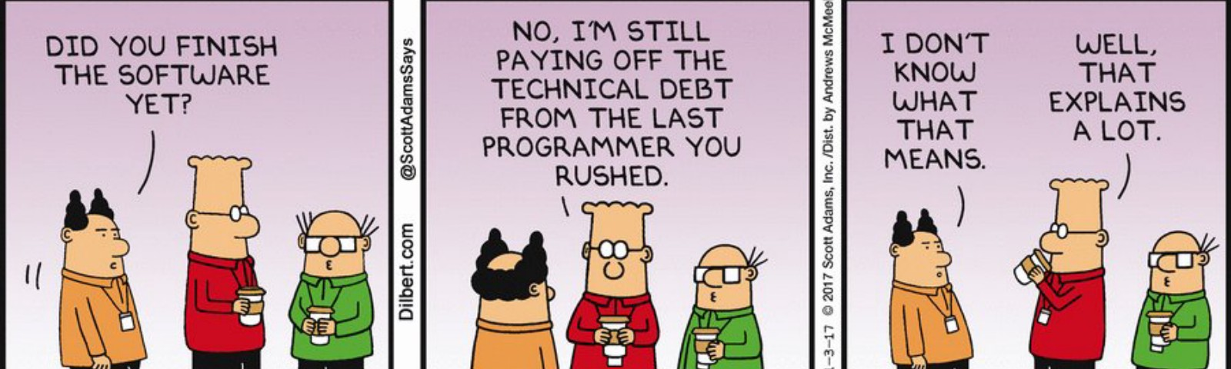
Technical Debt:
The price you will pay in the Future for continuing to build on top of poor designs in the Now.
Technical Debt:
The price you will pay in the Future for continuing to build on top of poor designs in the Now.

Slide 4
Your first job prospects:
Enterprise automation is made possible by proper event-driven integration of applications and data — that is, interconnecting the organization’s critical business data and applications, regardless of whether the data must flow from an on-premises location or the cloud. Companies spend big bucks to integrate their essential data and applications.
According to market research and intelligence reports, it is expected that by 2026 companies collectively will spend as much $20.9 billion annually to achieve enterprise application integration (Global Hybrid Integration Platform Market Size, Status and Forecast 2020-2026, valuates. com, 2020; https://reports.valuates.com/market-reports/ QYRE-Auto-19J2259/global-hybrid-integration-platform).
Problems => Job Opportunities for you!

Slide 5
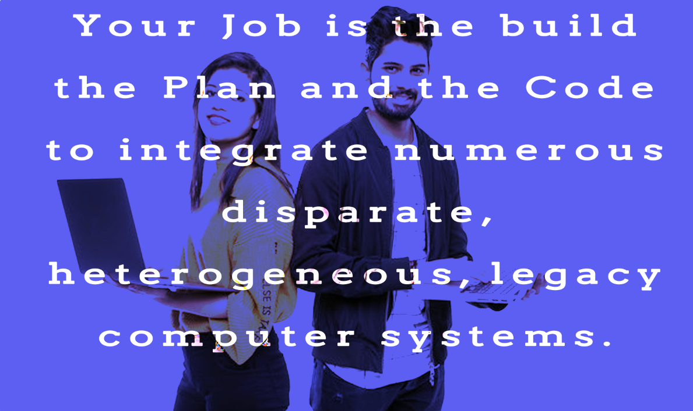
The Value Proposition of SOA: To Platformize the Enterprise: Connect INTO the Platform via TCP/IP / HTTP: 1. To Access Data via Remote method calls. 2. To Obtain Services via Remote method calls The Big Why of this Course is to learn how to leverage all the data, processes, and assets in the Enterprise Architecture to deliver the most amount of business value
And make the services and data provided by those components accessible via Web Applications as APIs.

Slide 6
Middleware is a set of translation protocols
Which enable the connection of numerous, messed-up, heterogeneous IT systems:
The things that may be different among all these systems may include:
Hardware
Data formats
Network formats
Application Programs

Slide 7
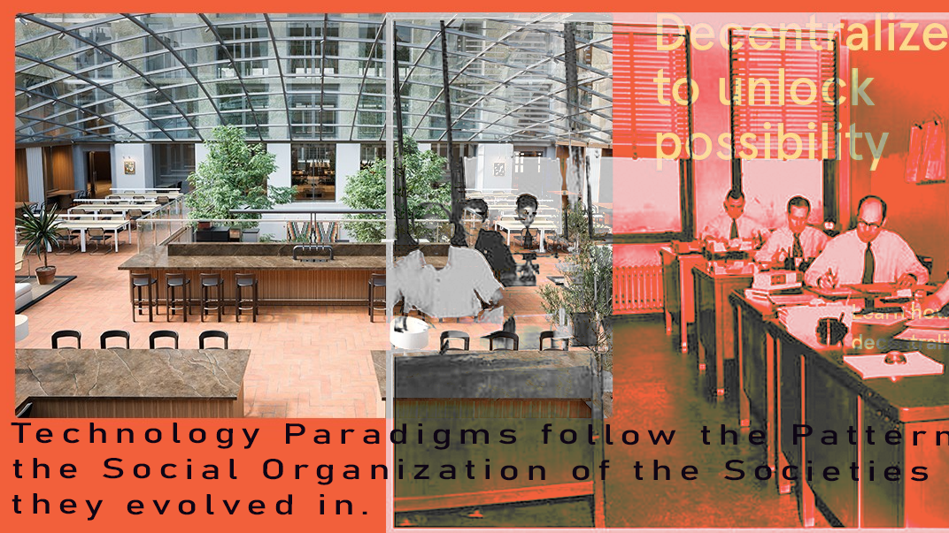

Slide 8
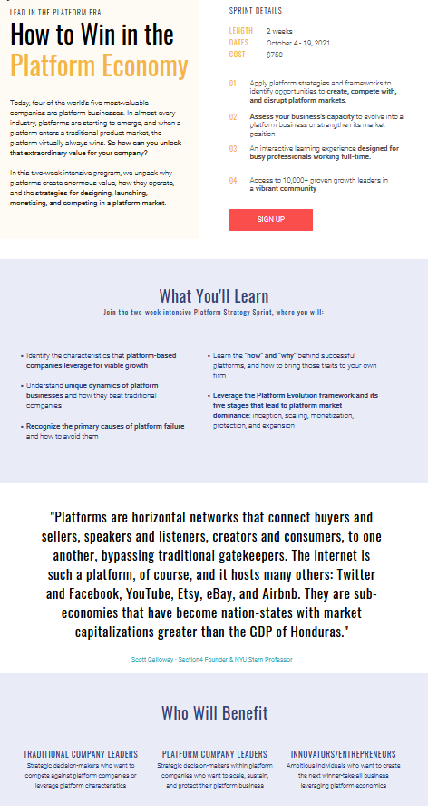
Our Goal is to build the Platform Business

Slide 9
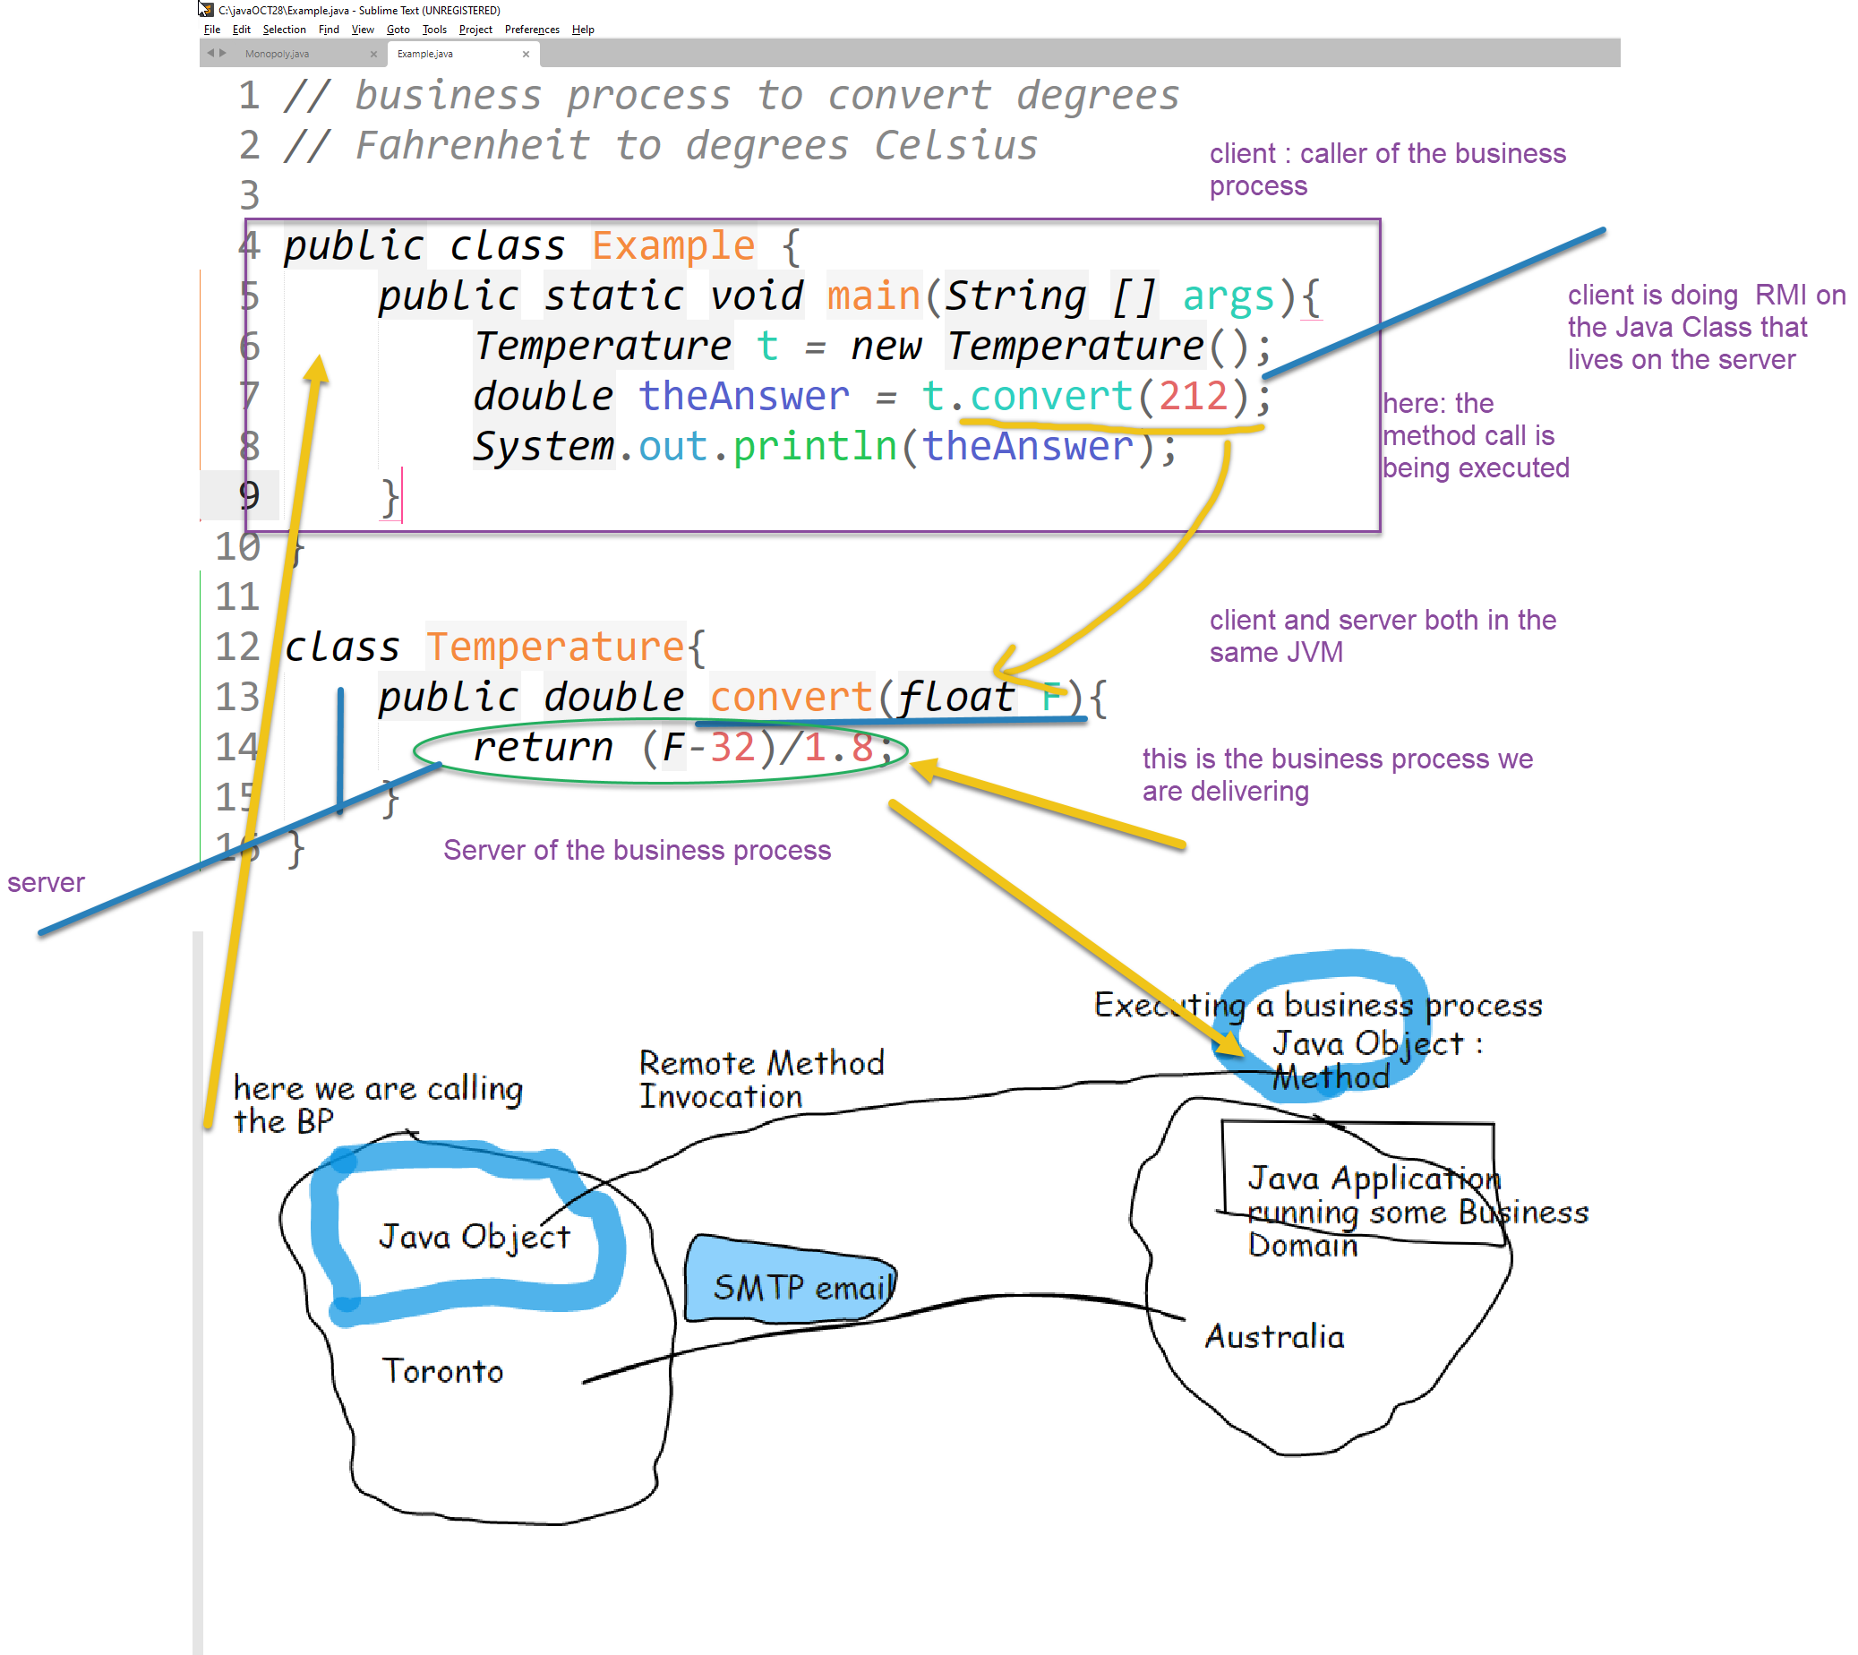
Some core concepts we must believe:
Important fact about the World ONE:
We can “realize” (bring to life) business processes by making Java Objects that Model them.
Important fact: here Business Process client and the Server are both living in the SAME JVM
To create the situation of Enterprise Middleware:
We would need the BP client in one JVM and the server in another: and they must be reachable to each other by TCP / IP. (Important fact about the World 2.

Slide 10
Test Question: What is Remote Method Invocation:
RMI is what happens when:
I have a Java Class (Class A) in one JVM
I have another Java Class (Class B) in another JVM: and both JVMs are connected by a TCP/IP connection
From Class A, I can call a method that lives in Class B

Slide 11
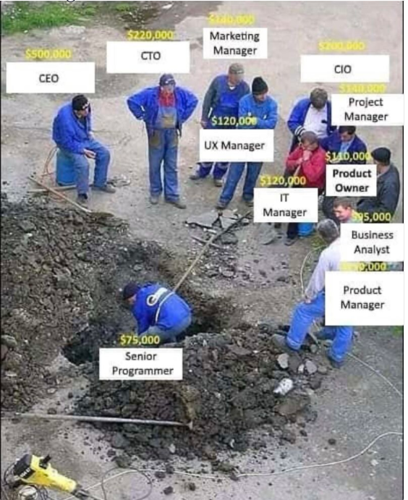
Describe the phases of Development of the Business Solution:
JAD : Project Ideation
Create user activity flows
WBS: plan time, cost, resources: factor these items into Sprints
Product Architecture Plan
UML diagrams, Traceability matrix, Test cases

Slide 12
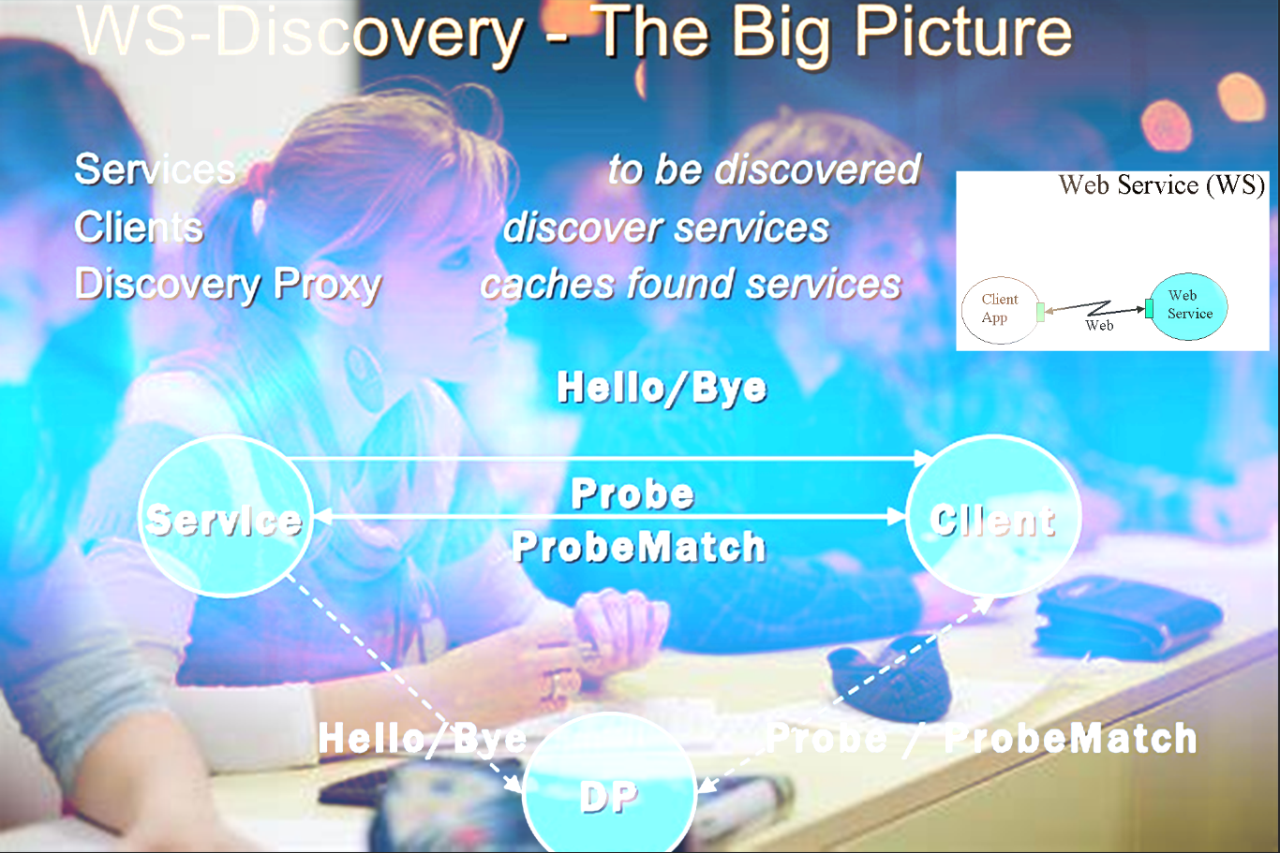
psigurdson@fanshawec.ca

Slide 13
Class Learning Resources:
Class Journal Google Doc:
https://docs.google.com/document/d/1evJ1dE-Xc7_oZeSin1yTSpXemdmxUwG1Xzlg9m9tWAc/edit?usp=sharing
How to do Lexical Analysis: https://youtu.be/DnCYcvRL9xg
Visual Learning Roadmap:
https://share.mindmanager.com/#publish/fNjDulYtaY7sjPwcDV-n6s-JGLM9fidSsr03GXOK
Annotated Course Outline:
https://www.dropbox.com/s/n900il32bm2joaz/INFO-6103.docx?dl=0

Slide 14
Course Visual Learning Roadmap:
https://share.mindmanager.com/?mm_link_external=true#publish/biFdOKL8uHXod2qENAoylISjMTEyvdh1NFgOZla5

Slide 15
J2EE and SOA
J2EE is an MVC code-oriented architecture component architecture
SOA is a DISTRIBUTED ARCHITECTURE. Components can be on any TCP addressable host.
You CANNOT distribute MVC components. Those patterns require running in the same JVM.

Slide 16
SOA Web Services are built on top of J2EE

Slide 17
An Enterprise Service Bus (ESB) is an architecture to support us in constructing distributed-Object Java Applications.
It is a set of rules and principles for integrating numerous applications together over a bus-like infrastructure.
ESB products enable users to build this type of architecture but vary in the way that they do it and the capabilities that they offer.
The core concept of the ESB architecture is that you integrate different applications by putting a communication bus between them and then enable each application to talk to the bus.
This decouples systems from each other, allowing them to communicate without dependency on or knowledge of other systems on the bus.
The concept of ESB was born out of the need to move away from point-to-point integration, which becomes brittle and hard to manage over time.
Point-to-point integration results in custom integration code being spread among applications with no central way to monitor or troubleshoot.

Slide 18
Summarize the key differences between Model View Controller and Server Oriented Architecture:
Model View Controller (MVC) is a design pattern where View describes the visual appearance of the solution, Model is the database, and Controller is the main functional backend code, also referred to as a MONOLITH. We had a single monolithic chunk of code in the earlier MVC controller architectures. There was no way to customise how use cases were executed through that Monolith. The controller serves as the app's entry point. The Controller is not referenced by the View. This Model is difficult to read, modify, unit test and reuse. MVC Model components may be tested separately of users. whereas in case of SOA
There are numerous minor modules in the PARADIGM for service-oriented architecture. We refer to these as components. both the Spring Boot and Java Jax frameworks These frameworks will provide APIs and services that enable the application to dynamically put together only the parts it requires to fulfil a particular use case while it is running. For eg: MVVM. Here the view serves as the application's entrance and has references to view model. When data bindings are complex, the debugging process will be challenging. It is simple to segregate unit testing from event-driven code.

Slide 19

ESB is a set of rules and principles for integrating numerous applications together over a bus-like infrastructure.
ESB products enable users to build this type of architecture but vary in the way that they do it and the capabilities that they offer.
It is a software platform used to distribute work among connected components of an application.
ESB is designed to provide a uniform means of moving work, offering applications the ability to connect to the ESB and subscribe to messages based on simple structural and business policy rules.

Slide 20

ESB is a constitution that enables SOA architecture in distributed environment.
Its based-on service providers, service consumers and event flows.
Service providers generates events and publish to event bus, its also called as ESB.
Service consumers consume events they are interested in from that ESB.
ESB supports synchronous and asynchronous events.
Two types of bus are available in ESB Software and Hardware
The Enterprise Service Bus (ESB) is a software architecture that connects all the services together over a bus-like infrastructure. It is used to create integrations between applications.
It performs transformations of data models, handles connectivity/messaging, performs routing, converts communication protocols and potentially manages the composition of multiple requests.
It performs transformations of data models, handles connectivity/messaging, performs routing, converts communication protocols and potentially manages the composition of multiple requests

Slide 21
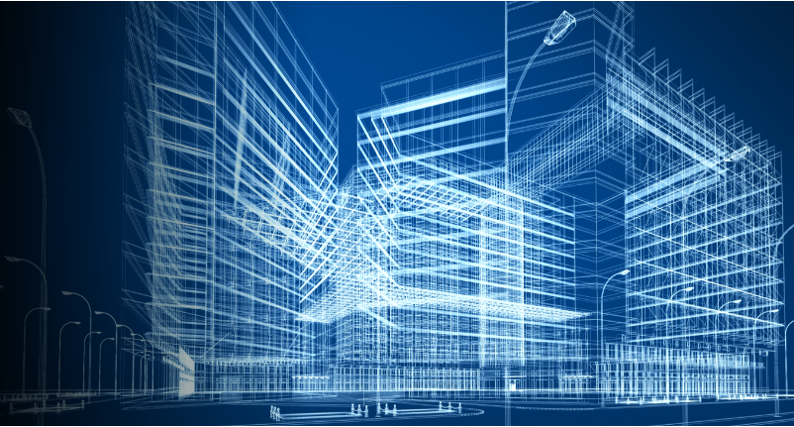
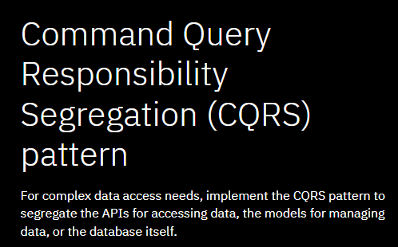
https://www.ibm.com/cloud/architecture/architectures/event-driven-cqrs-pattern/

Slide 22
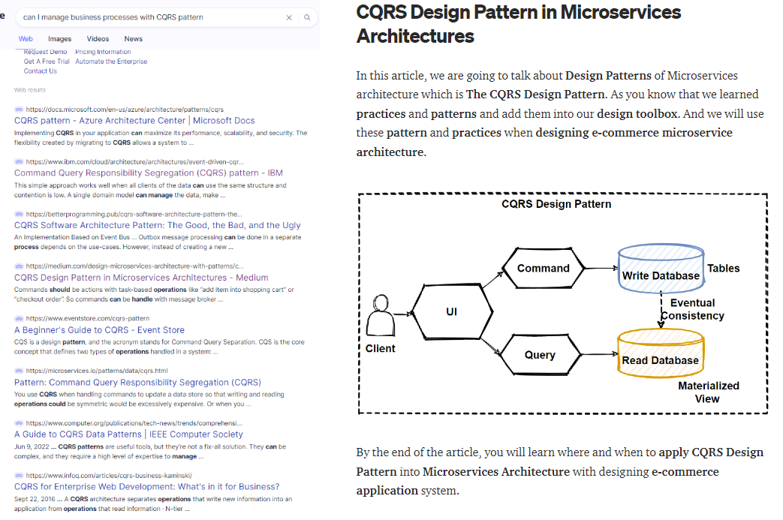
https://medium.com/design-microservices-architecture-with-patterns/cqrs-design-pattern-in-microservices-architectures-5d41e359768c

Slide 23
What roles do the protocols of SOAP and WSDL play in the building the Service Oriented Architecture:
Both SOAP and WSDL are XML based services. SOAP is a XML based network protocol that is used for exchanging structured data between nodes. SOAP uses Hypertext Transfer Protocol (HTTP), Simple Mail Transfer Protocol (SMTP), Transmission Control Protocol etc. SOAP is an envelope we wrap around our Java Classes to let them live and work and communication in a SPRING BOOT Framework.
WSDL is an XML based interface definition language that is used in describing the web service functionalities. XML is a document that can be read by any programing language thus making both SOAP and WSDL very useful from the point of view of SOA.

Slide 24
Discuss the concept of the Enterprise Service Bus:
An Enterprise Service Bus (ESB) is fundamentally an architecture. It's idea is to create integrations between applications using a centralized software component. It is a set of rules and principles for integrating numerous applications together over a bus-like infrastructure. The core concept of the ESB architecture is that you integrate different applications by putting a communication bus between them and then enable each application to talk to the bus. This decouples systems from each other, allowing them to communicate without dependency on or knowledge of other systems on the bus.

Slide 25
Analysis Phrase
Gather User Stories
[UI PROTOTYPING/Interviewing/
job shadowing
Turn them into the Requirements Document using Lexical Analysis
Design Phrase
We create UML entities based on a lexical analysis of our Use Cases.
In the Design Phase: We want to be agnostic of the details of HOW we do the technology implementation.
Think only in terms of INTENTIONALITIES: What do you want to do: Not how to do it.
Write your Intentionality Statements.
Implementation Phrase
Create objects from our UML Entities:
Write the Code
Create the data schema for the database
OS Configuration
Network configuration
Case : Computer Aided Software Engineering
Examples you will encounter at work include Rational Rose, Visual Paradigm
Business Domain Lives Here.
Use Cases belong in the Analysis Phase because they are our TOOL for doing Business Process Discovery.
UML Diagrams belong to the Design Phase because this is how we design our component architecture.
Roundtrip engineering: as you are writing code, you might go back to revise your UML Design to make it work better in the code domain

Slide 26
Summarize the key differences between Model View Controller and Server Oriented Architecture:
Server Oriented Architecture It is a software development approach that enables services to connect across platforms and languages in order to construct apps. A service is self-contained and is designed to fulfil a specified purpose. SOA enables distinct services to communicate with one another via loose coupling in order to transmit data or coordinate action.
MVC is an abbreviation for model-view-controller. The backend includes all of the data logic, while the frontend, or graphical user interface, displays it (GUI) The application's brains that regulate how data is presented. It is a software design pattern that is often used to construct user interfaces, data, and controlling logic. It stresses the separation of business logic and appearance in software.

Slide 27
What is a Serverless Architecture: Why is this pattern important in SOA?
A technique for creating and delivering applications and services without the need to maintain infrastructure is called serverless architecture.
Serverless architectures provide higher scalability, more flexibility, and faster time to release for many developers, all at a lower cost.
Developers no longer have to worry about acquiring, provisioning, and managing backend servers thanks to serverless architectures.
Although 'serverless' computing does occur on servers, developers are never need to interact with the servers. The seller is in charge of them.
Serverless architecture is an approach to software design that allows developers to build and run services without having to manage the underlying infrastructure. Developers can write and distribute code, and a cloud provider will set up servers to run their databases, storage systems, and apps at any size. This article will discuss serverless architecture, including how it functions, the advantages and disadvantages of using it, as well as some tools that can make the transition easier.
The serverless app architecture provides the execution of cloud-based working environments on-demand. In contrast to monolithic and microservice architectures, serverless architecture frees customers to concentrate solely on product development by offloading management and server configuration to the cloud provider.

Slide 28
Serverless Architecture is FaaS (function as a service).
In microservice architecture we know that we have controllers for every service we perform. Such as logging, data storage and API endpoints.
If we take out common functions from our microservices we only end up with business logic.
In this SOA architecture, we just deploy our functions to accomplish over task instead of deploying code for our service.
It’s an important pattern because we can run our services without the need for infrastructure management.

Slide 29
What is a Serverless Architecture: Why is this pattern important in SOA?
Consider that when SQL database technology became available : programmers were now free to concentrate on the semantic details of how they wanted the data to behave not the mechanical structural details of how to organize the data plumbing ; they could push the data into the SQL container and let the container be in charge of managing the data mechanics
In an analogous manner, in a serverless deployment environment: the developer can concentrate on the semantic behavioural aspects of the system and trust the container to take care of provisioning the application as externally requestable resources
https://www.dropbox.com/s/fznig7y86a5a41e/AWS_Serverless_Multi-Tier_Architectures.pdf?dl=0

Slide 30
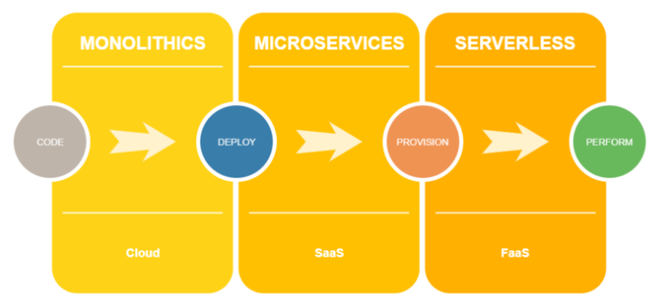
https://www.wizeline.com/what-is-a-serverless-architecture/

Slide 31
What roles do the protocols of SOAP and WSDL play in the building the Service Oriented Architecture:
SOAP It specifies the usage of XML for request and response parameters while utilizing HTTP as a transport protocol. Provides a wire protocol that specifies the structure of service-related communications as they are exchanged over the Internet. SOAP provides a stateless programming architecture and uses HTTP to deliver XML-encoded serialised method argument data from system to system (one-way message exchange paradigm) SOAP is perhaps the most interoperable wire protocol developed, thanks to XML and HTTP.
WSDL It is a service representation language that is used to express the specifics of the whole interface offered by web services in order to use a web service. It is also an XML-based specification template for expressing a web service's public interface. The service provider can provide to the service requestor all specifications for invoking a web service.

Slide 32

What roles do the protocols of SOAP and WSDL play in building the Service Oriented Architecture:
SOAP It specifies the usage of XML for request and response parameters while utilising HTTP as a transport protocol. Provides a wire protocol that specifies the structure of service-related communications as they are exchanged over the Internet. SOAP provides a stateless programming architecture and uses HTTP to deliver XML-encoded serialised method argument data from system to system (one-way message exchange paradigm) SOAP is perhaps the most interoperable wire protocol developed, thanks to XML and HTTP.
WSDL It is a service representation language that is used to express the specifics of the whole interface offered by web services in order to use a web service. It is also an XML-based specification template for expressing a web service's public interface. The service provider can provide to the service requestor all specifications for invoking a web service.

Slide 33
Explain why it is the TIGHT BINDING is a negative design pattern the Model View Controller architectural pattern:
Tight coupling is generally undesirable because it limits the flexibility and reusability of the code, makes changes considerably more challenging, hinders testability, etc.
Tightly Coupled Objects are objects that depend heavily on each other's interfaces and need to know a lot about one another. In a small program, we can clearly recognize the changes and there is little opportunity to miss anything.
In a tightly connected application, changing one object frequently necessitates changing a number of other objects. However, not every programmer is aware of these interdependencies in large projects, and there is a potential that modifications could be missed. However, no two sets of loosely connected items are interdependent.
In order to lessen the likelihood that modifications to one component may necessitate changes to any other component, loose coupling is a design objective that aims to minimise the interdependencies between system components. A far more general idea known as "loose coupling" aims to boost a system's adaptability, make it easier to maintain, and make the entire framework more "stable."
The degree of direct knowledge that one element has about another is referred to as coupling. A and B, for instance, only alter their behaviours when A does the same. It is simple to decompose a loosely linked system into discrete parts.

Slide 34
What is The Business?
The Business Domain
SOAP
The set of all the Activities it takes to run the business:
Workflows
Simple Object Access Protocol
A SOAP Frame is a box you put business processes and data into
Hardware
Software: Application Software
Data, Data formats,
The Technology Platform

Slide 35
The Core Theme of this Course: How to Platformize the Enterprise
Microservices is the enabling technology for Implementing Service Oriented Architecture.
Watch this Video: https://app.knowmia.com/oBHo
How to model Hardware in a UML Diagram
First goal = MODEL business processes in Software (Java)
How do we make an SOA Architecture out of this stuff?
Data
Business Processes
Database
Write Java Classes to execute business processes
Mediator Design Pattern
SOA is a set of Instructions on HOW to “Platformize” the Business Model
SOA is a technology and business practice set to Platformize the Enterprise.
Data
Hardware
Business Processes
Knowledge and instructions on what to do to run the business
The Business Model
data
The Enterprise = The Company’s IT Operating Platform
All of the stuff it takes to run the company IS the Platform
3 Things we need to operate a Business IT System
processes
hardware
Copyright: Peter Sigurdson Technology Training Services

Slide 36
What things do we need to do in our SOA Implementation to check all the SOA Quality boxes? This is your Skills Inventory from this Course: All the things you have learned here:
Business IT Domain
Business Process Domain
IT Enterprise Infrastructure Project Management
Enterprise Application Integration and SAD System Analysis and Design
The Technology Model is the UML Diagrams
The Enterprise = The collection of business processes and other assets
In terms of Unified Process: The Model is:
The architecture is :
The UML Diagram
This is the Company – The Business we are modelling
Model the Enterprise: by writing Java Code to operate the Business Processes
The Business Model is the Business Processes
This is where YOU are:
Unified Process= User Stories
Use Case Discovery
UML Diagrams
Develop IT Artifacts
How do we BRIDGE
These DOMAINS
Enterprise Modeling= creating Java Components to realize / run the Business Processes [BPMN/BPEL]
We create Use Cases to DISCOVER what the business processes ARE
WE need a tool set to DESCRIBE and to CHANGE the Business Processes to make them work with our SOA Architecture
Business Process Modelling Notation BPMN
TECHNICAL Domain = is what the INFORMATICS TEAM wants
Business Analyst works here
The Output from this phase of the Enterprise Modelling = The Software Application.
Business Domain = is what the Business Users want
DEVOPS work here
We will use Spring Boot Framework and JAX-RS
Copyright: Peter Sigurdson Technology Training Services

Slide 37
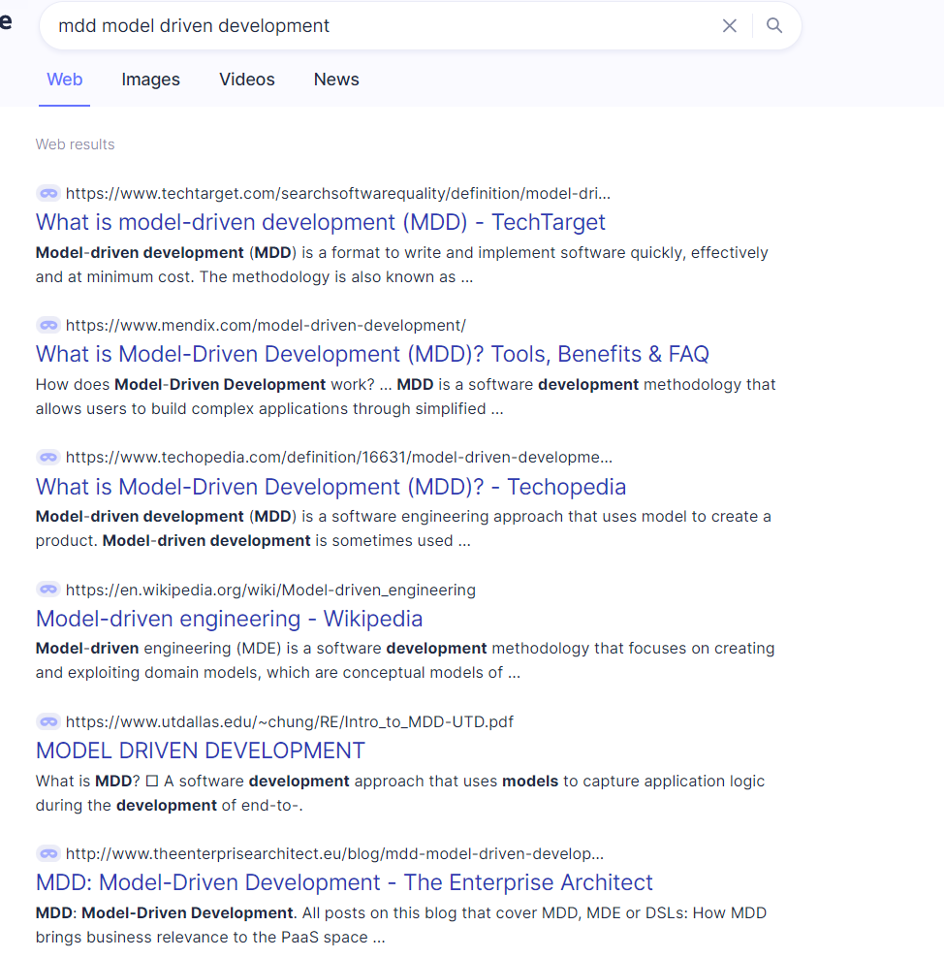
This is a Course about Model Driven Development MDD

Slide 38
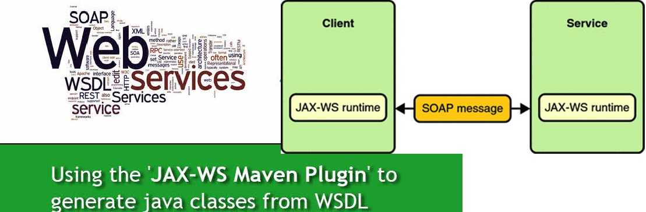
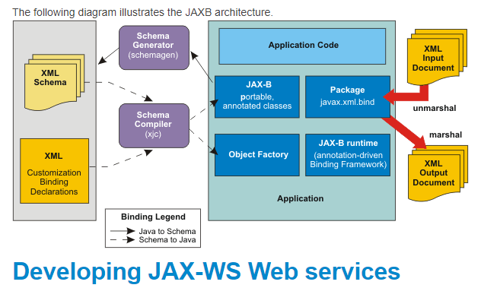
Work Procedure for deploying a WEB SERVICE

Slide 39
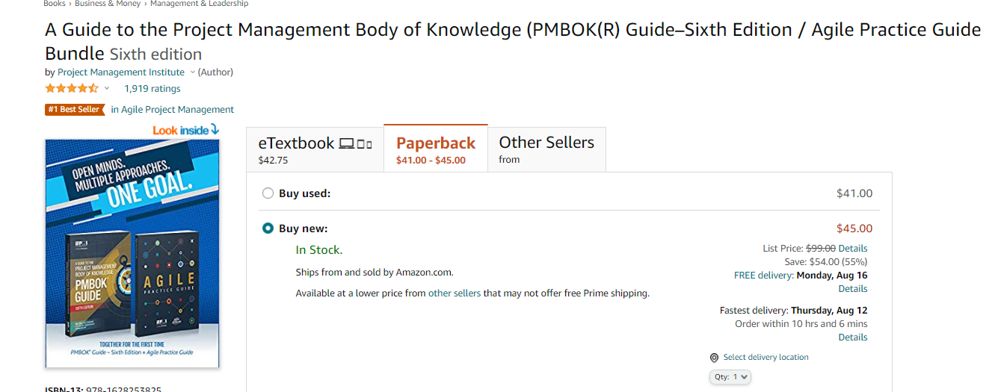
The 2 Goals of AGILE:
Increase the Cognitive Bandwidth of the Developers and the Team. Cognition is thinking. Bandwidth is how much information you can put into the communication channel.
Create a Shared Mental Space among the Development Team.
These goals in Agile are achieved by creating a common vocabulary of words and concepts that developers can discourse in the context of.
Agile is a Software Engineering Methodology.
Unified Process is a Software Project Management Methodology.
UML, Use Cases, Traceability Matrix

Slide 40
Describe what you understand to be the purpose of this Course, and what TOOLS you are learning to deliver these Goals:
Unified Process: Software Project Management Methodology
Agile: Software Development methodology
Gathering User Requirements: UI Prototyping, Interviewing
“The Glass is the User’s Experience of the System”
Use Cases: Discover Business Process Discovery
We use Lexical Analysis to: generate Use Cases from User Stories forward generate UML from Use Cases
Traceability Matrix: write your classes/methods along the top row
Write your Requirements down the rows.

Slide 41
What is a Use Case?
How do we use Use Cases to build the Enterprise Application in Java?
Use case is one single unique, complete end to end path of transit through the system that delivers value to some stakeholder. Use case is also a wrapper for a Business Process.
We turn the Use Cases into UML Entities. We draw and design the business process and connect them together. Java Classes, Mediators provides our connection to Databases, POI, or other external resources and we are now connected to the Enterprise Application.

Slide 42
Service Interfaces.
SOA, or service-oriented architecture, characterizes a method for making programming parts reusable and interoperable by means of service interfaces. Services use normal connection point principles and a structural example so they can be quickly integrated into new applications. This eliminates assignments from the application designer who recently redeveloped or copied existing usefulness or needed to know how to interface or give interoperability to existing capabilities. Each service in an SOA typifies the code and information expected to execute a total, discrete business capability.
The service interfaces give free coupling, meaning they can be called with practically no information on how the service is executed, decreasing the conditions between applications.

Slide 43
How does UML assist us in building an Enterprise Modeling Solution:
Ensure that we capture ALL the requirements and entities in the business domain. ™
Optimize how the classes communicate (CID and OID)

Slide 44
Discuss the 2 aspects of designing a Program (=a community of OBJECTS)
We are working in Java.
We are designing Classes: (1) Fields, (2) Methods
Putting the right FIELDS in each class so the classes share information by FIELD COMPOSITION
Writing methods in the right ways so we can share information between objects with METHOD calls:
There are 2 things that a method has: Method Signature MyMethod(int a, String name) Method Signature is the set of parameters we pass into the Method Invocation)
Method has a RETURN TYPE: the primitive or object data that is returned from the METHOD Call, to the POINT of INVOCATION.

Slide 45
Describe what the Enterprise is - and how do we "model" it?
The Enterprise is the set of all the “stuff” that runs the business.
We write Java classes to wrap up, encapsulate, contain the Business Processes. We write Java Mediator Classes to wrap up databases and webservers so we can actuate those resources by applying METHOD calls and get the result set back as the RETURN Value of the Method Call.
Mediator is a translator between business processes and platform assets. We write our business processes in java classes and these classes should be able to communicate with databases and serves. Mediator java classes enable the communication between them.

Slide 46
Discuss the UML Concept of Appropriate Assignment of Responsibility (The Knowledge Principle)
We model the Business Domain (meaning all the operations that the business can do) by writing Java Objects.
Java objects have DATA and METHODS.
“The knowledge Principle” is a HEURISTIC to help us decide which object to use to perform a certain task. The Knowledge Principle says: The Object that has the most knowledge about something, for example: A Warehouse Database Object, should be the object we use to do tasks related to that knowledge, such as making a Purchase Order.

Slide 47
What do we mean by remote method invocation?
Web Services IS JUST calling methods that are in a Java Object which lives in a remote JVM: that is accessible via an HTTP Stream over a TCP PIPE.

Slide 48
What is the purpose of UML =- How do we do UML and why?
UML is a notational language that enables us to design Java Classes to model a business Domain.

Slide 49
Enterprise Application Integration:
What is it: Accessing Data and Method Calls across different JVMs.
The Business Domain = {The set of all the business processes and data} that deliver the Company’s Value Output}
HOW do we Platformize the Business Domain – meaning: set ourselves up to be able to (1) data read/write, (2) run processes by calling methods?
Define: Business Object IS A Java Class that delivers a business process (HOW? Unified Process turns Business Descriptions (AKA Use Cases) into Java Objects and Database schema)
We put Business Objects into SOAP Wrappers. These business objects, which use an XML communication protocol called WSDL, are how we access DATA and DO METHOD INVOCATION {SERVICE CALLS}.
EAI means we operate the Business Domain as a Java Program.

Slide 50
What is a Web Service?
Web Service = A Method INVOCATION over a TCP PIPE / HTTP

Slide 51
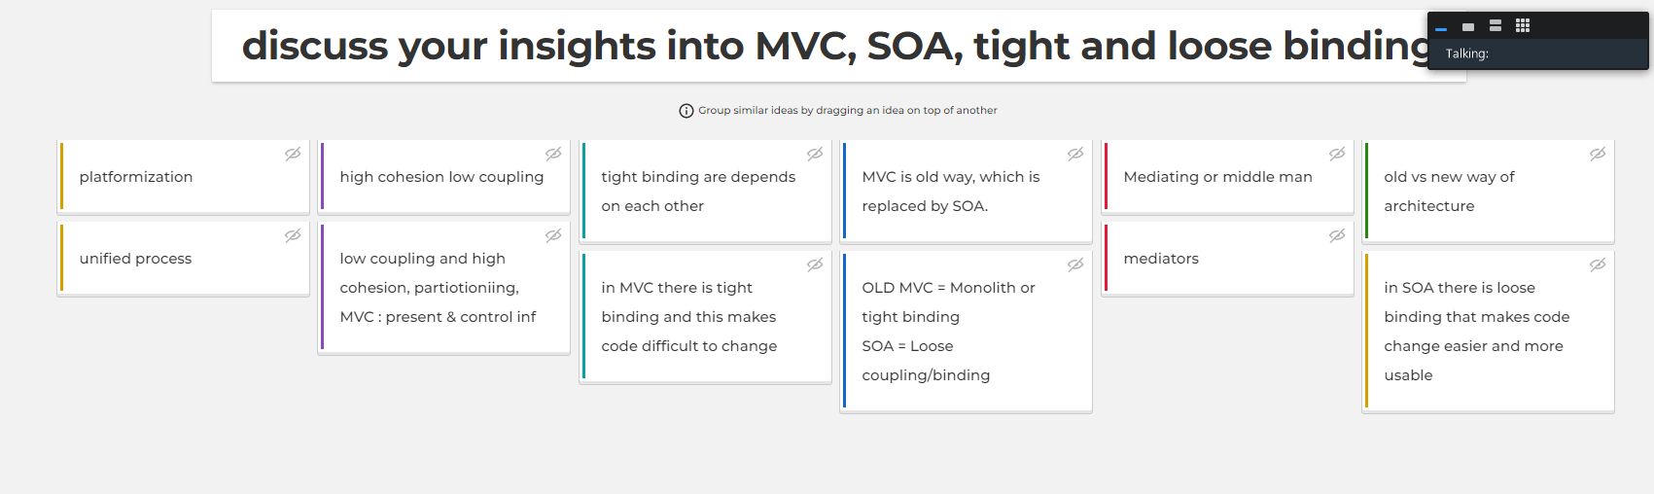
MVC: The monolith: CODE-oriented architecture.
Tight binding between Algorithm = a collection of methods
SOA: a tapestry of threads; each thread is one Algorithm
LOOSE Coupling between Algorithm = a easy to intermix algorithms: we can store business rules = algorithms in the Database. We can change the Algorithms dynamically at runtime.

Slide 52
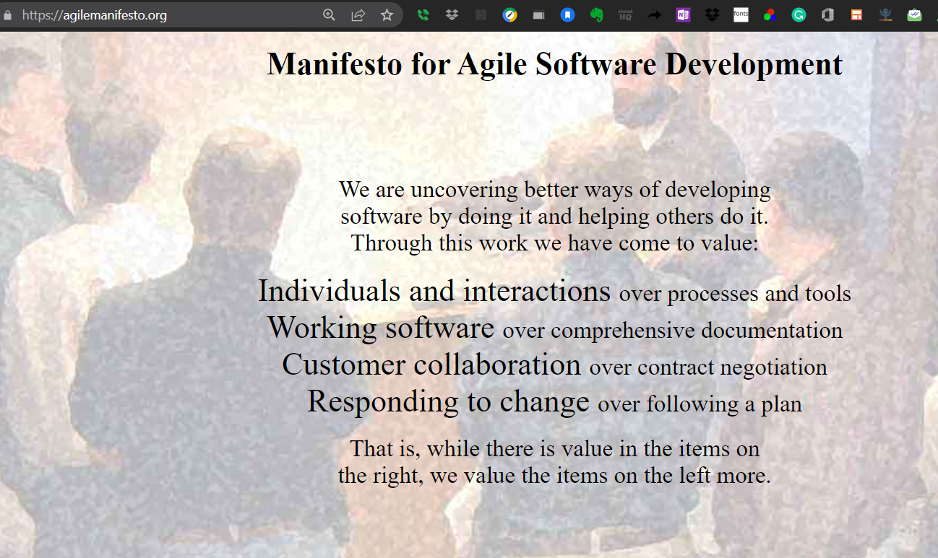

Slide 53
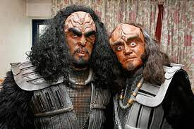
The Klingon Programmer's Code of Honour
All Klingons who develop code for the glory of the empire follow this "Code of Honour" for software "code warriors".
Specifications are for the weak and timid.
State-of-the-art hardware is a prerequisite to do battle with code.
One cannot truly appreciate "Dilbert" without reading it in the original Klingon.
Indentation is for enemy skulls, not code.
Klingons do not "release" software. Klingon software escapes, leaving a bloody trail of design engineers and quality assurance people in its path.
Klingon function calls have no parameters. They have arguments! And they always win them.
Klingons do not debug. Our software does not coddle the weak.
Quality Assurance issues are best solved with a Batleth.
A true Klingon warrior does not comment his code.
Our users shall know fear and cower before our software! Ship it! Ship it and let them flee like the dogs they are!
PFEQ: State your Favorite of the Klingon’s Rules for Programming

Slide 54
SOLID Principles:
High Cohesion:
A class can have 2 kinds of attributes:
Data Fields
Methods
High cohesion: One class delivers 1 Use Case (one business process)
Low or Loose Coupling:
Classes should exhibit strong encapsulation
Therefore, the class's ‘services’ which are the methods, can be invoked to get that return value without having to change the implementation details of the class.
Loose Coupling = Tight “separation” or Tight Partitioning.

Slide 55
Agile
Unified Process
Agile is a Software Engineering Methodology:
Means: our input is: Use Cases
Workflow: turn Use Cases into UML := Forward Generate Java Code from the UML Diagram
Unified Process =
SDLC Methodology PLUS
Project Management methodology
Start by gather user requirements:
UC => UML => Java Code => TM, which is the basis of how we generate test cases.
Unified Process is a software development lifecycle methodology which means it is also a project management methodology. The software crisis arose because we tried to treat developing software projects the same as developing construction projects.
(Class discussion question: can you name the four things which are different between developing a construction project and developing the software project. this will come back to you later as a test question!)
Think about Unified Process as a special kind of a box into which we put the agile software engineering methodology. agile informs us as to how to convert requirements into a structured formulation called UML diagrams which we can then forward generate Java objects and database schema from. but there is more stuff you need besides just generating code and database schema. you need all the project management aspects: risk resource time and cost control documents, project charter and statement of work, and the magical work breakdown structure which is our bridge between our project plan and our software development plan. these are all the secret ingredients which Unified Process brings to the table which is more than what Agile does.

Slide 56
Agile and Unified Process
Project Management
PMI BOK
(CAPM EXAM):
Controlling
Costs
Risks
Resources
Schedules
Software Engineering:
AGILE BEST PRACTICES GUIDE
Practices for writing quality code:
Endpoint: Traceability Matrix
https://www.dropbox.com/sh/ua6yppm87wgklz0/AADfgAD8MRw-yfOQk-pFKMrRa?dl=0

Slide 57
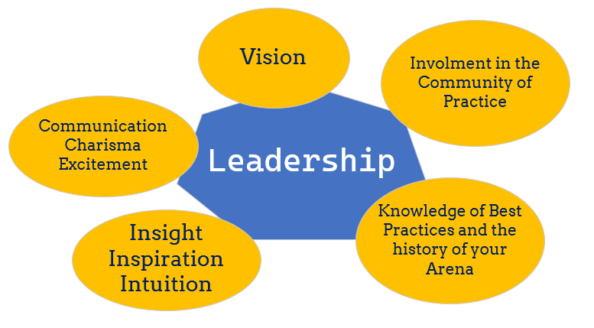

Slide 58
CAREER PROGRESSION PATH FOR THE IT PROFESSIONAL
START AS JUNIOR PROGRAMMER / ANALYST: IN THIS ROLE THE PROGRAM TEAM LEADER GIVES YOU A LITTLE PROBLEM TO SOLVE AND YOU WRITE CODE TO SOLVE IT
AFTER A YEAR: YOU WILL PROMOTED TO SENIOR PROGRAMMER ANALYST
IN A COUPLE OF YEARS (ONCE YOU KNOW THE PRODUCT AND THE CODE AND THE PROBLEMS OF THE CUSTOMER OR BUSINESS DOMAIN): YOU WILL BE PROMOTED TO TEAM LEADER
NEXT STEP IS TO BE AN INFORMATION ARCHITECT: CODE + INFRASTRUCTURE (= PRODUCT +THE BUSINESS DOMAIN)
SENIOR MANAGER // PROGRAM PROJECT MANAGER
PROMOTED TO THE LEADERSHIP LEVEL, CHIEF INFORMATION OFFICIER
ITEMS 4 AND 5 ARE THE PROFESSIONALS WHO WOULD BE IN CHARGE OF DESIGNING THE BUSINESS RULES WHICH THE PRODUCT DELIVERS.

Slide 59
Learning Resources
Resources and Learning Materials on UML and Unified Process
https://www.dropbox.com/sh/ua6yppm87wgklz0/AADfgAD8MRw-yfOQk-pFKMrRa?dl=0
Annotated Course Outline:
https://www.dropbox.com/s/jp9fzzjek4x2y39/INFO-6103.docx?dl=0

Slide 60
Learning Resources:

Slide 61
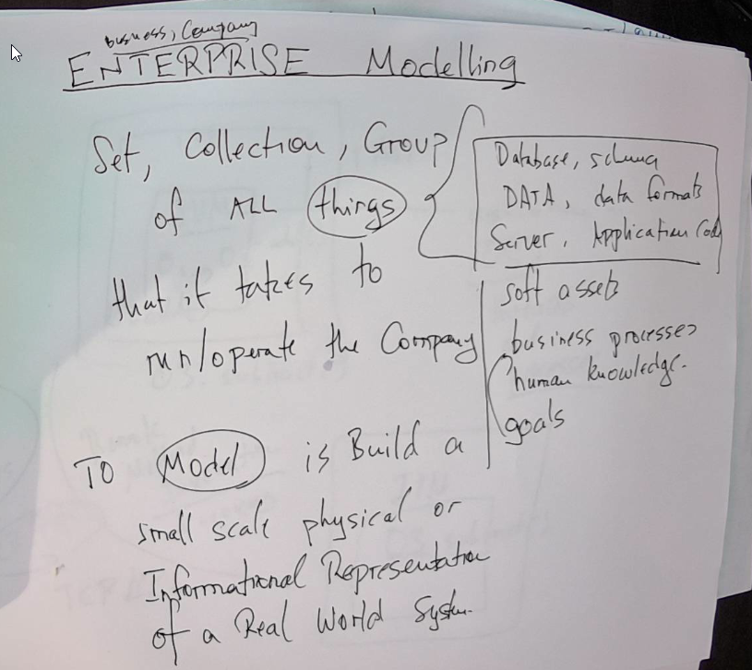
The GOAL of Enterprise Modeling is to PLATFORMIZE the Enterprise
A Platform = A set of APIs that we can give to Developers to construct software applications to construct business value.
How do we do Enterprise Application Integration EAI:
Write Java Classes to represent/mediate access to/ or wrap around the Enterprise Artifacts
Write Java Web Services / Spring Framework code to connect to those artifacts and allow access to and control by Web Interface (POI Point of Interaction)
ARTIFACTS

Slide 62
How do we build an informational representation of an Enterprise?
One of the business uses of computers was to create and run SIMULATIONS
The methodology that evolved starting from the 1980s is Unified Process.
Unified Process is based on a Notational Diagramming System called UML: Unified Process

Slide 63
Enterprise Application Integration = Platformizing The Enterprise
2 Things that the Platform will provide:
Access to Data
Access to Services
3 qualities of an OBJECT in the OO paradigm:
Object has:
Unique Identify
Data Attributes
Methods

Slide 64
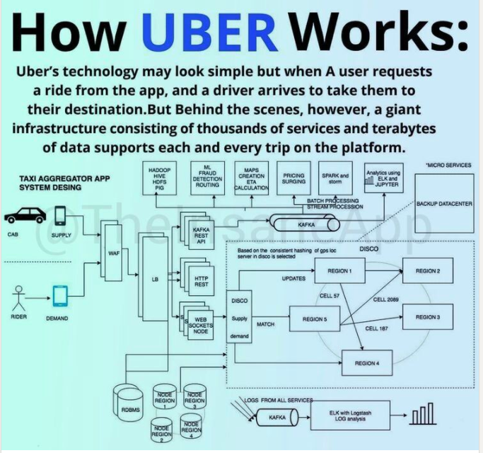

Slide 65
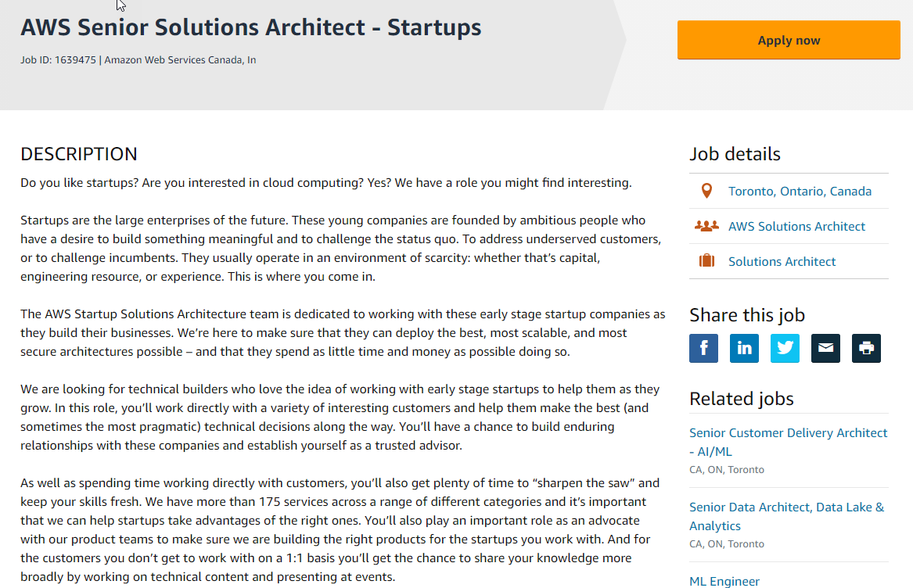

Slide 66
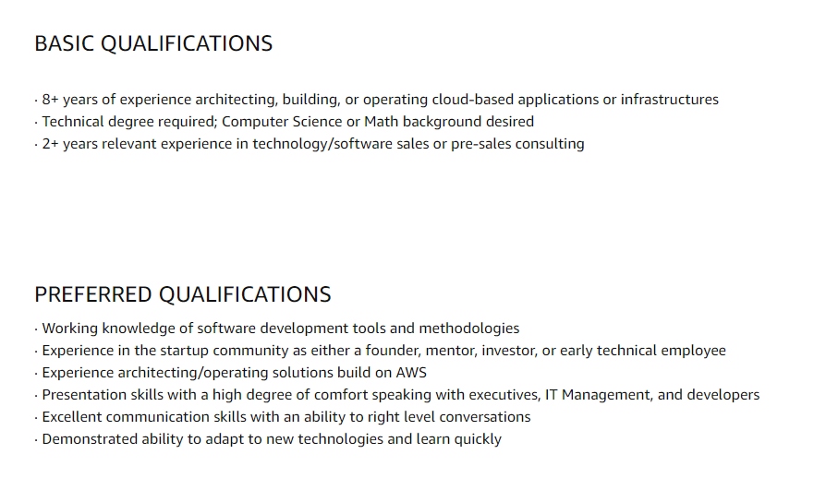

Slide 67
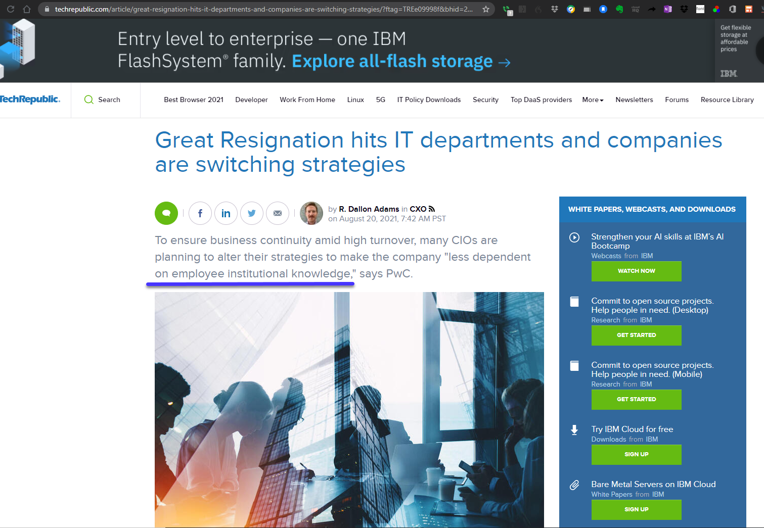
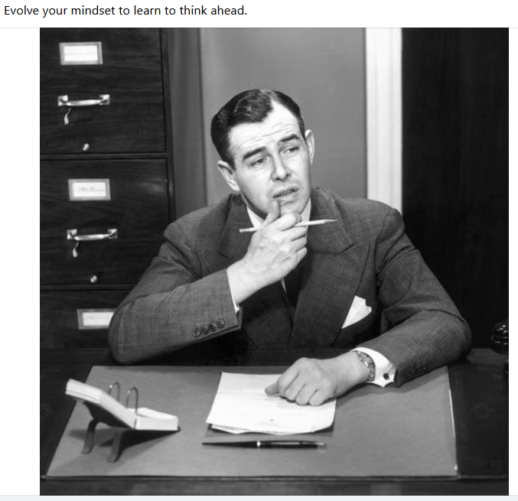
Employee
Institutional
Knowledge
https://www.techrepublic.com/article/great-resignation-hits-it-departments-and-companies-are-switching-strategies/?ftag=TREe09998f&bhid=26449071841962371431093923417046&mid=13483581&cid=933104084

Slide 68
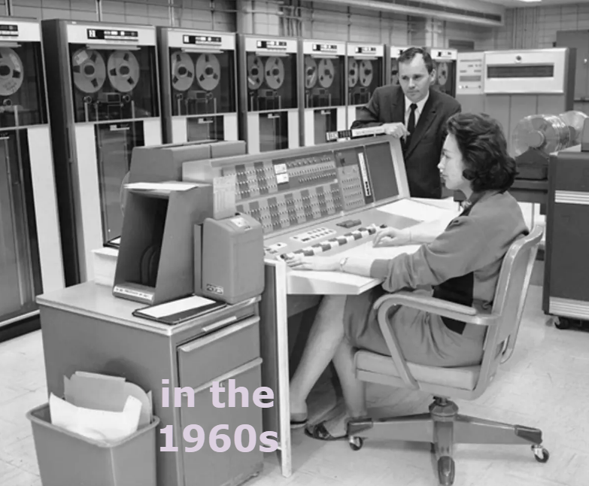
There are 2 ways to build web applications:
The model was stored on tape
Model View Controller
Web Services APIs and RESTful Services
Model View Controller is the OLD way: This pattern goes back to the 1950s when the computer was a Big Server in a server room; user had a “dumb terminal” (think Google/Chrome Notebooks: simple tablets that can run only a browser. No other software).

Slide 69
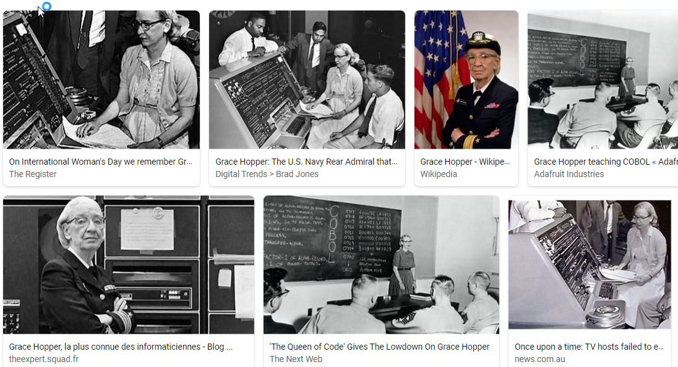
All new applications are now done using the pattern of Web Services and RESTful APIs
Why?
The Model View Controller has 1 very big advantage in todays’s world:
90% of the world’s software is written in COBOL – from the 1950s!
COBOL was invented in the 1950s by retired US Navy Admiral Grace Hooper.

Slide 70
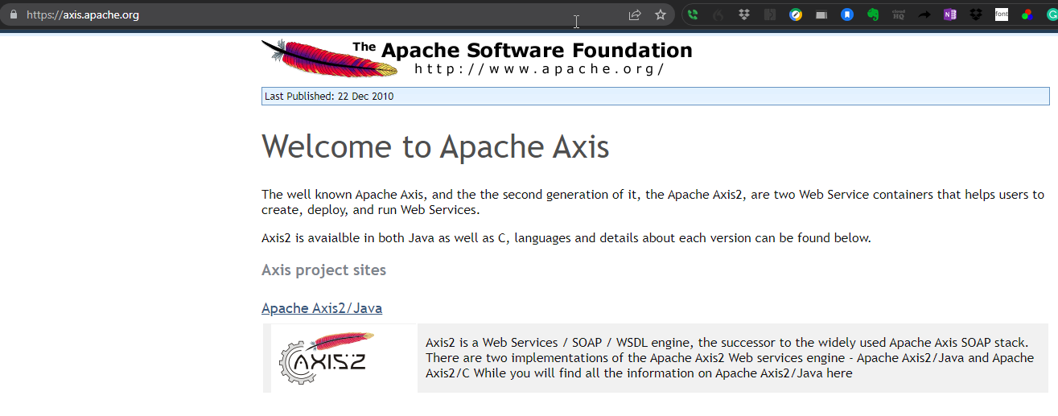

Slide 71
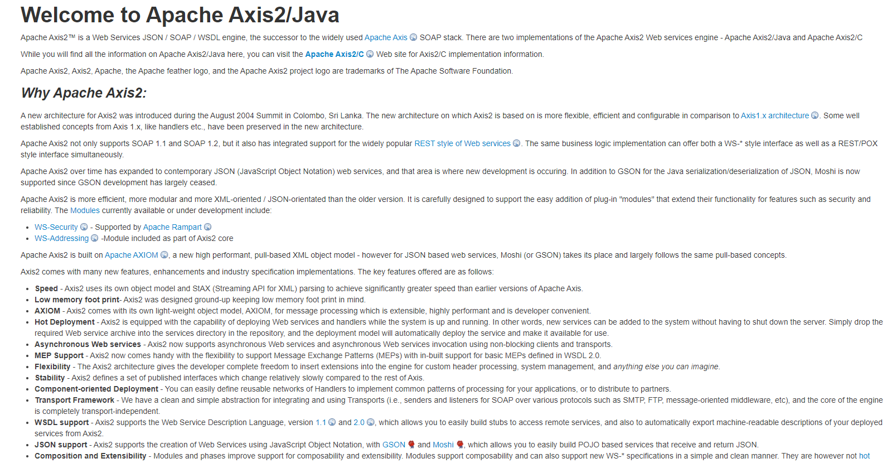
https://axis.apache.org/axis2/java/core/index.html

Slide 72
How and Why to Do UML:
Plan out in advance, before you start writing CODE, all the Important Details of your Application:
Think about what classes you need: which comes from a Lexical Analysis of your Use Cases.
Come up with meaningful names for data fields and methods
Behavioral Partitioning: Come up the Names for your Classes: and plan which methods (containers for the behaviors of your Algorithm) you will park in each class
Do the same thing for your Data Fields: What do I need and which classes will I put them in.
The reason WHY you did points 1 and 2 is to plan/design HOW the Data Plumbing of Application classes will be organized.

Slide 73
Watch / Read / Learn:
Using Unified Process:
https://youtu.be/2uzrgAfVhsI
Doing Unified Process with AGILE:
https://www.dropbox.com/s/sgcn3ruho3gxu1p/agile%20project%20management%20with%20use%20cases%20and%20uml%20to%20do%20unified%20process%202.pptx?dl=0
Doing Lexical Analysis:
https://youtu.be/DnCYcvRL9xg
Watch the Video on how to use Unified Process:
https://www.dropbox.com/sh/ua6yppm87wgklz0/AADfgAD8MRw-yfOQk-pFKMrRa?dl=0
UML:
https://www.dropbox.com/sh/t98hh4ldjxdtbbs/AAAiGHybUWLqHRPAw-cyLrMqa?dl=0
User Stories: https://www.dropbox.com/sh/93ds2si70k4erpg/AACQ0mPkaKxazt0vsiegmvUoa?dl=0

Slide 74
Videos and Learning Resources:
https://app.knowmia.com/m6K1 How to do Assignment 1
https://app.knowmia.com/vdcb How to use Unified Process to implement a Service Oriented Architecture
https://app.knowmia.com/ZqDL Final Exam prep from a previous term
Course Content review: https://app.knowmia.com/qhqj
How Service Oriented Architectures work:
https://app.knowmia.com/oBHo

Slide 75
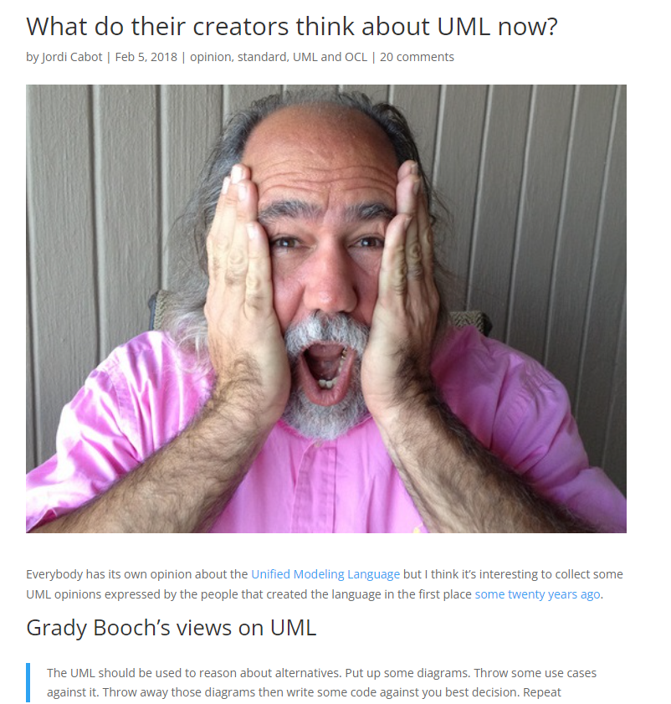
https://modeling-languages.com/uml-opinions-creators/
Ivar Jacobson’s opinion on UML
He starts by stating loud and clear that rumors of the death of UML are all false.
Other highlights:
UML is not the silver bullet it was sold as ten years ago. Nor it is as bad as academicians, agilistas and competitors claimed five years ago
There are two major challenges to be addressed: complexity of the UML specification itself, and the need to describe UML in coherent subsets that address the actual needs of users in particular domains
UML has become complex and clumsy. For 80% of all software only 20% of UML is needed.
If UML is used in a smart way, it is very practical and results in products with higher value. UML is a great language to create architectures. It works very well for agile teams.
Read some additional quotes/comments here and here.

Slide 76
Google Docs Lecture Notes
https://docs.google.com/document/d/1evJ1dE-Xc7_oZeSin1yTSpXemdmxUwG1Xzlg9m9tWAc/edit?usp=sharing

Slide 77
In the Algorithm Economy: we are seeing a transition from THE PIPELINE to the PLATFORM
Platform Business: make a bunch of product; keep it in a Store: people would go to the Store to buy
Platform Business Model:
Connector: Amazon is PIPELINE: connect suppliers to purchasers:
Payment Processor
Reputational Mechanism
Airbnb, UBER
Old Days: physical goods
=> Digital Goods: zero duplication costs, strong network effect
https://www.dropbox.com/sh/8gvoj7bbs4dy3d6/AAApqAIR7vuqGzK3Zpl5BLYNa?dl=0

Slide 78
Service Oriented Architectures and Modelling the Business Domain
Watch this video: https://app.knowmia.com/oBHo
From 1993 – and continuing: One of the big design patterns was MVC Model: Database
View: POI : point of interaction with user: HTML and HTTP
Controller: implement our Algorithms and Business Rules
In MVC: MONO = one, LITHIC = stone
Controller is a monolith
We need Service Oriented Architecture to make EAI Enterprise Application Integration Work. SOA = like a Tapestry of cloth

Slide 79
CORBA: The solutions get better: the problems stay the same! Discovery and Connection
Common
OBJECT
Request
Broker Access
“Broker Access” => The CORBA Framework managed the housekeeping details:
Discovering, and connecting
Disparate OBJECTs with Service (a method call is a service) and getting the result back and using it in our own program.

Slide 80
EAI architectures ARE created using the principles of Service Oriented Architectures:
This means in a Consumer Java Class: we do a method invocation on a Java Class that lives in another JVM accessible by a TCP/IP connection
We will be using Java and a Java Web Services Framework called Spring WS (Spring Web Services) – this is what makes the SOAP and WSDL happen
You might see CORBA/RMI being used in old legacy systems: Computer Object Request Broker Access
SOAP or CORBA: the engine that makes it work is Remote Method Invocation

Slide 81
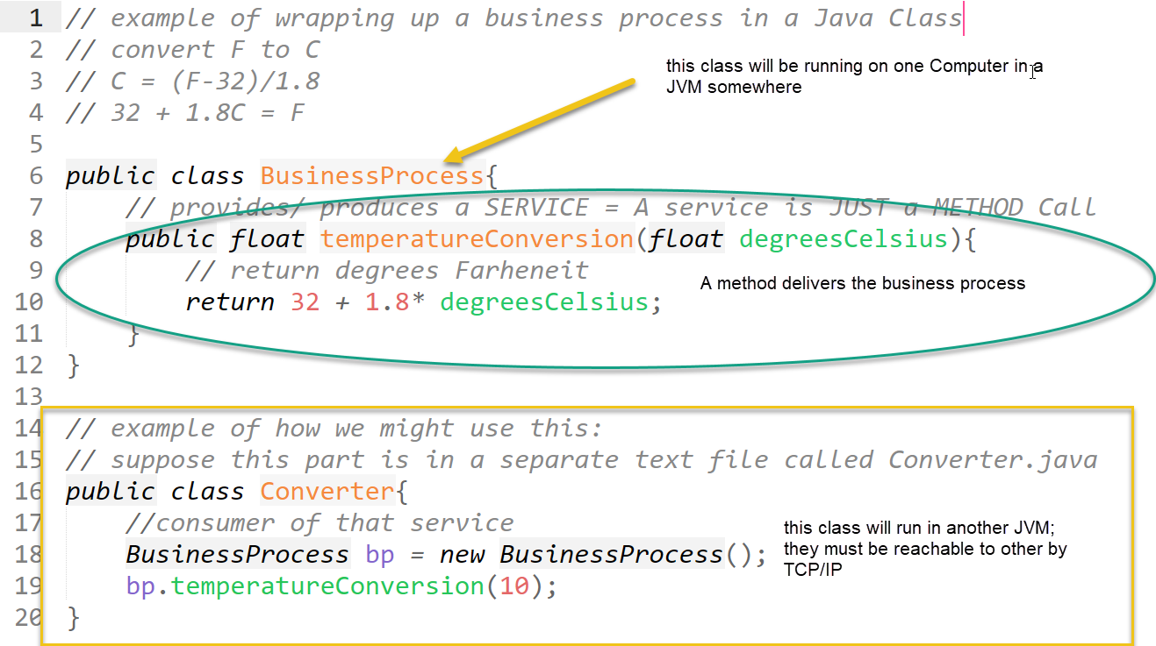
SOAP is the HANDLER PROTOCOL that provides a framework to put this method into a box and convey it to another endpoint
SOAP gets me from the producer to the consumer

Slide 82
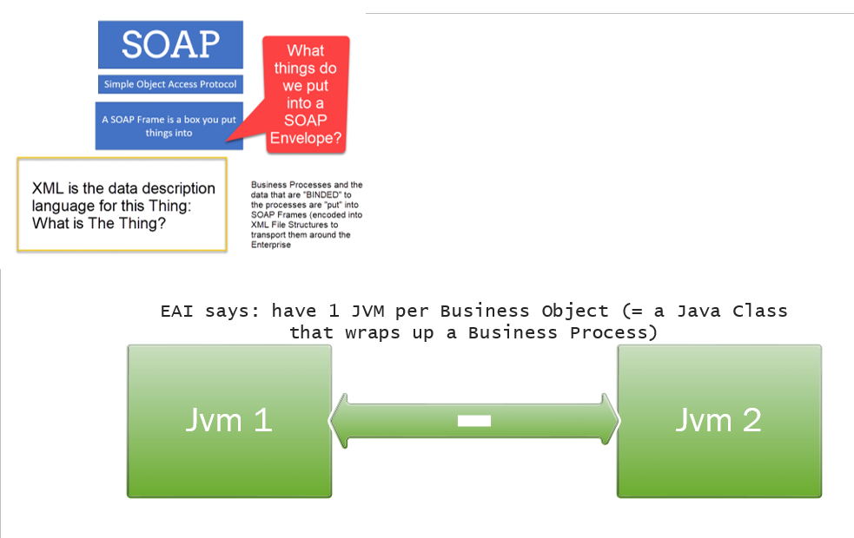

Slide 83
SOAP is the HANDLER PROTOCOL that provides a framework to put this method into a box and convey it to another endpoint
How does Converter class: discover and then connect to the provider of the service it needs?
SOAP gets me from the producer to the consumer

Slide 84
SOAP is the packaging protocol that let’s us package up a Business Object to use its services at another end point
SOAP => sort of like TCP
Web Services Discovery Language:
WSDL is the handler protocol that provides:
Discovery of services: WSDL creates a file, a Catalog, that advertises available services
Traffic Routing: WSDL drives the SOAP packets between endpoints.
WSDL is the protocol that enables the UDDI Universal Data Discovery Interface.

Slide 85
Enterprise Modelling works like this:
What is the meaning of SOAP and WSDL
SOAP and WSDL are protocols for constructing Enterprise Application Integration programs: Which is what we are doing when we do Enterprise Modeling
We will use Java, Java Web Services component framework and the Spring Framework to implement SOAP and WSDL

Slide 86
Enterprise Application Integration is what we do when we connect:
The Java Classes that are the containers for business processes
The Java Classes that are Mediators that wrap around Platform Assets like Database Server and HTTP Server
A use case is a description of a business process
Our Workflow to do EAI is to create connections between all these Java Classes (endpoint)
Java Class that enables communication to Database via JDBC
Business Process Java Class
doQuery(sql)
Database:
How to talk to that Database in my Java Application
JDBC ResultSet (Java Collection Object)

Slide 87
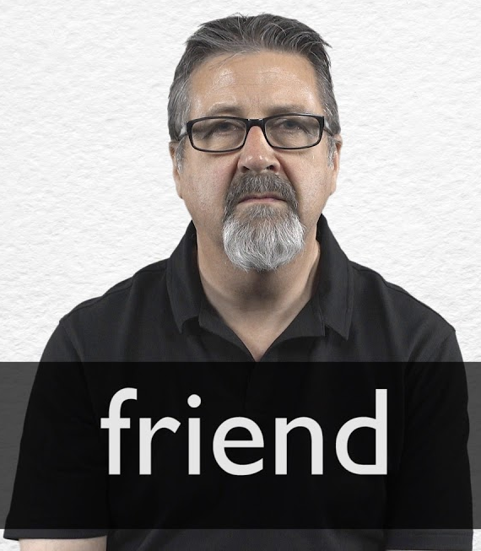


A mediator class is a Translator
JORGE
Joe
Jorge is the middleware
Maria
English
Spanish
English
Spanish
Speaks English and Spanish
Mediator
Speaks only Spanish
Speaks only English
We write Java Mediator Classes to wrap up databases and webservers so we can actuate those resources by applying METHOD calls and get the result set back as the RETURN Value of the Method Call.

Slide 88
Can we really put a business process into a Java Class?
Because a Java Object is a box into which we can put any kind of information and ship that box around over TCP PIPE.

Slide 89
SOA is a set of Instructions on HOW to “Platformize” the Business Model
Data
Hardware
Our keys to understanding
Service
Oriented
Architecture
What is a SERVICE in the context of SOA?
Business Processes
A business value deliverable
reusable, reproducible: Value Token
What is connection does this have with Java Programming?
CONNECT JAVA PROGRAMMING TO SERVICES

Slide 90
What is the purpose of a computer program?
Optimizing processes with a help of programs which otherwise would take a lot of people hours.
A computer program is a machine (set of instructions) for converting data from an input state to an output, to create new value.

Slide 91
Making UML Diagrams
For your Labs and Assignments, you will make UML Diagrams
Visio – other drawing tools
My suggestion: Draw on paper : take a picture: Google Drive it up
Embed this image in your Presentation format
I don’t like drawing tools – because – you spend too much time playing with the computer: Instead, you should draw by hand to focus on the problem you are solving.

Slide 92
MVC pattern provides reusability
Yes but that is not the reason WHY we do it!
The reason why we use this pattern is to implement our goal of creating a software application which has a high degree of fidelity to our UML Design.

Slide 93
Create optical focus and clarity on the Teaching Paradigm for this Course:
The factor that makes this work, and that makes SOA different that Code-oriented Architectures (MVC) is that we encode the business processes as BPEL instructions in the MODEL.
In COA, we encoded the Business Processes in code constructs in the coding of the Controller
Programming and Algorithm Development
We Focus on Building and Operating Business Processes
This is Service Oriented Architecture
Data Schema Design
Pour into the MOLD of the Process Choreography
We take a Process-First Mindset

Slide 94
SOA Value Checklist concerns:
An enterprise automation, or application and data integration, platform interconnects the vital operations of a business. An app and data integration platform enables data and operational infor- mation to flow between functional teams like finance, accounting, sales, marketing, manufacturing and analytics, and others. Also importantly, cloud-based app and data driven enterprise automa- tion places companies in a position to effectively and swiftly react to sudden, unexpected shifts in the business climate.

Slide 95
» Integration is the act of interconnecting applications and systems to flow or share data between them for operational, data storage, or data analytics purposes.
» Operational means at the time of the business execution or application software activity. In other words, happening in real time or near real-time, important for automating
business processes.
» Application integration refers to interconnecting two or more applications to flow operational data between them to execute software functions.
» Data integration means flowing post-operational data from applications, operational databases, or other systems of record to a data storage repository or data warehouse to consolidate data and/or to perform post-operational analytics on the data.

Slide 96
An essential component of enterprise modeling and automation is integration, which involves interconnecting applications and systems together to flow or share data and also to share method (service) access between them.
Learning Outcomes:
how integration has evolved, and the role integration plays in the success of an organization, company, or enterprise.

Slide 97
SOA Business Concerns:
combined data and application integration

Slide 98
It will also benefit you to be familiar with the newly emerging focus in Commercial IT of CI/CD Continuous Integration/Continuous Delivery:
You can review my course materials on this subject here:
https://www.dropbox.com/s/raydvqtdg95if9h/AML3304_Lecture%20Notes%202021F.pptx?dl=0

Slide 99
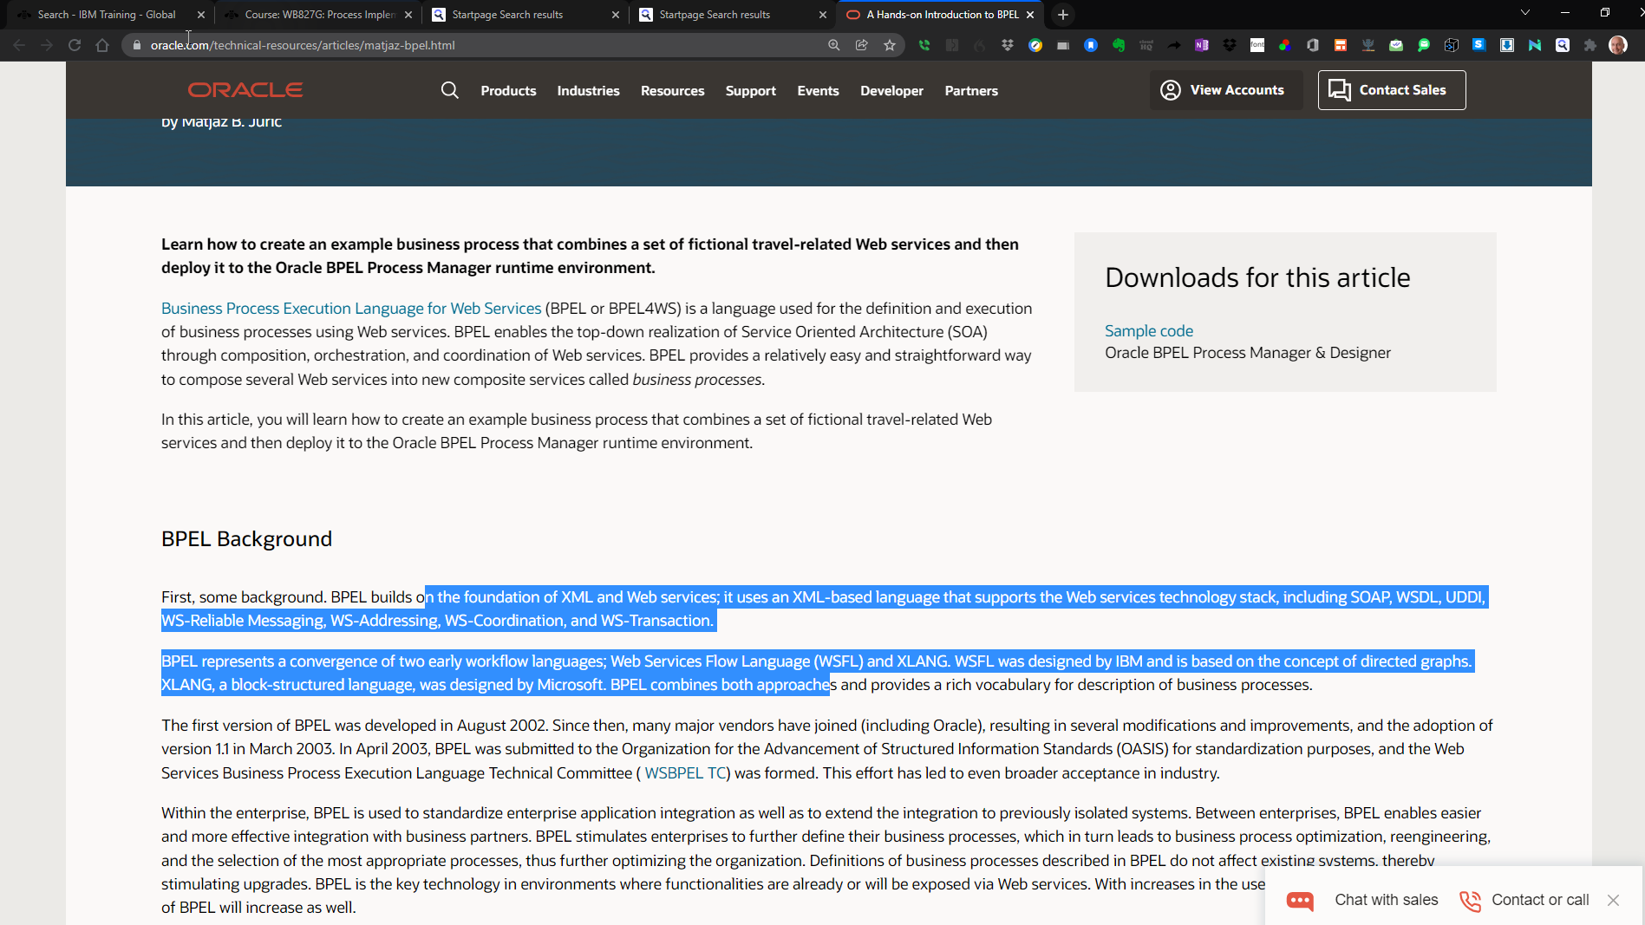

Slide 100
Course Learning Roadmap
Using BPMN and BPEL
Storing BPMN and BPEL in a Database
Using Spring Framework
Programming SOAP and WSDL

Slide 101
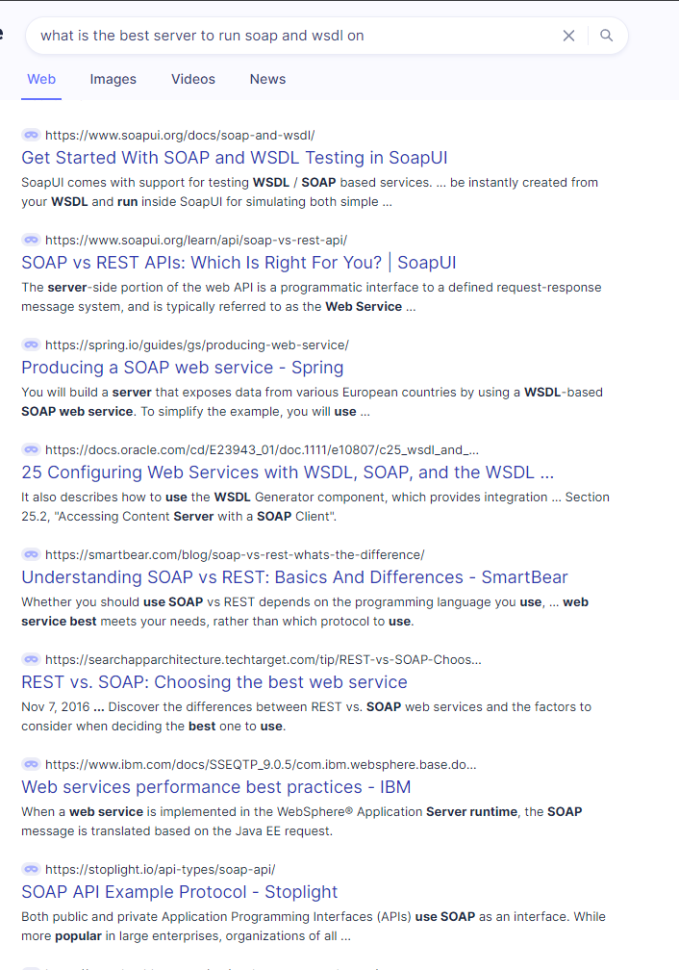

Slide 102
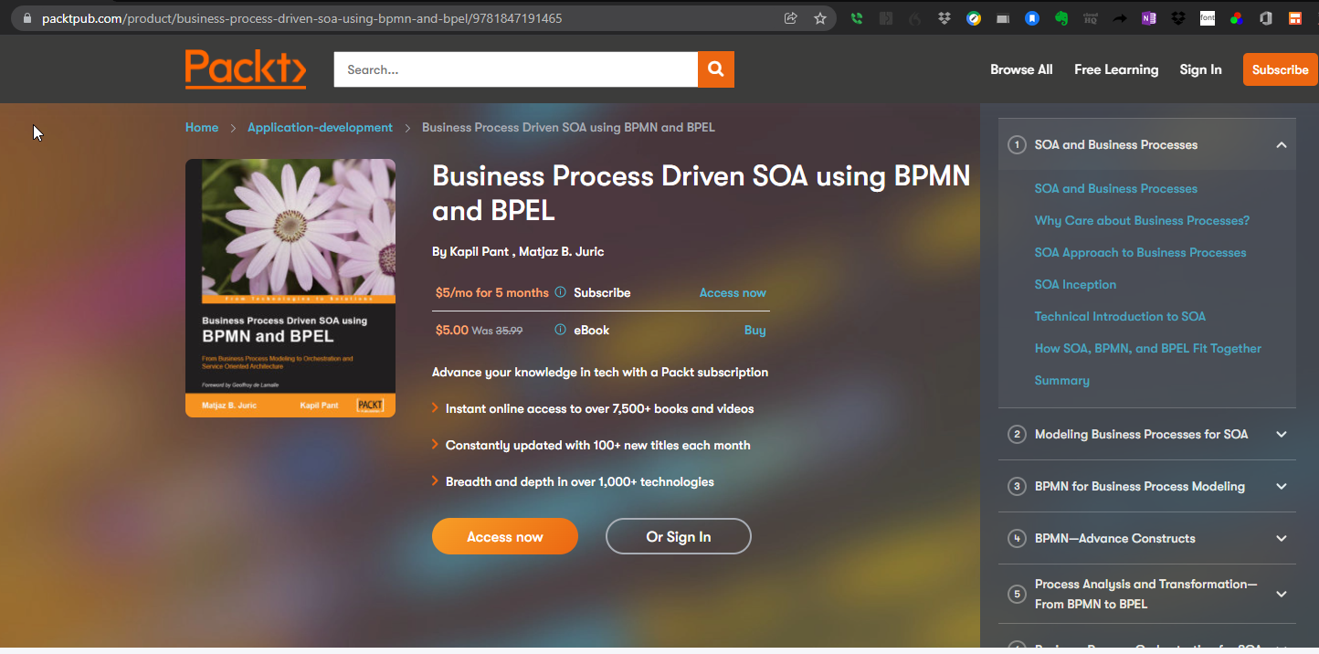
https://www.packtpub.com/product/business-process-driven-soa-using-bpmn-and-bpel/9781847191465

Slide 103
DIY Integrations with Spring Framework
DIY Integrations with Spring Framework

Slide 104
You should be aware of the total spectrum of the 3 Concerns to you as an INFORMATICS SPECIALIST:
Write GOOD Code:
UML design
Use of architectural patterns and code designs
How to make the code available to our User and Customers:
Running the CI/CD Devops Pipeline as efficiently as possible using the DEVOPS pipeline.
Using for Example a Tool like JENKINS.
Problem inception development and solution design:
Addressed by Unified Process

Slide 105
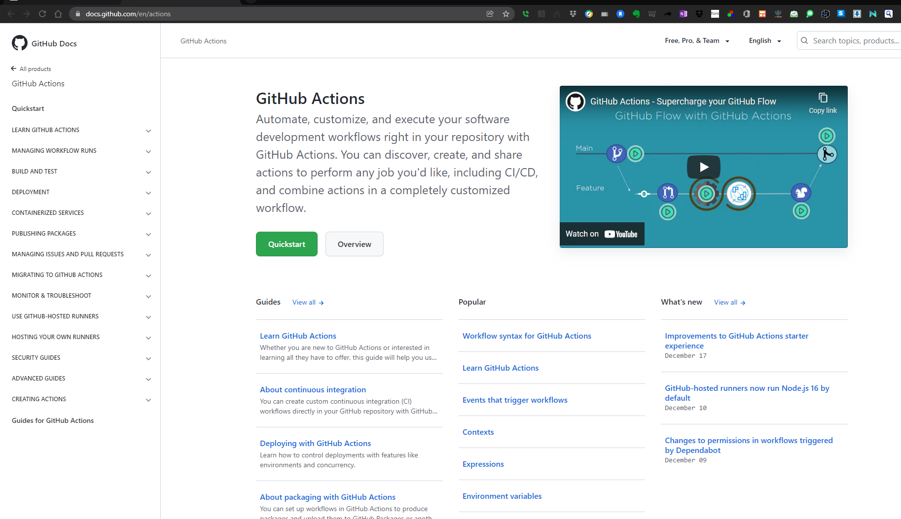

Slide 106
Kubernetics Containers: The best practice to quickly setup your Laptop to write Java-delivered SOAP Programs
SOA is NOT a Java Programming Framework
SOA is a set of Intentionality Statements about WHAT the Enterprise Application Integration Frameworks should DO and how they should BEHAVE – to service the business goals in the most potent and useful way.
Microservices
Continuous Integration/
Continuous Delivery
Service-Oriented Architectures
SOAP and WSDL
THESE are EAI Frameworks
Java Spring Framework
Architectural Patterns to implement the Business Processes and GOALs of SOA
J2EE Servlets, JSP, EJB, JPA
Technologies to deliver and realize SOA Intentions

Slide 107
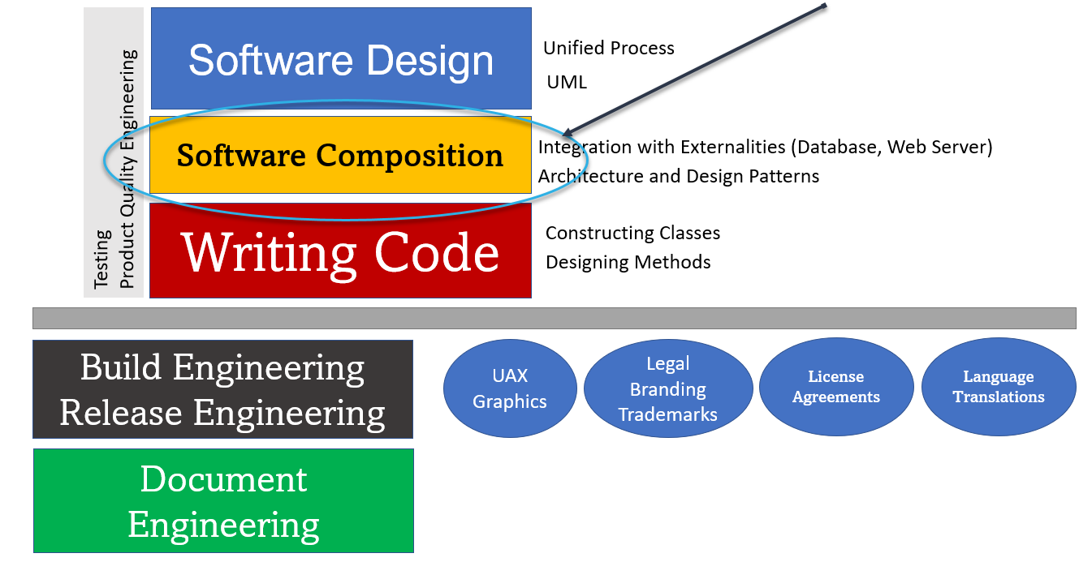

Slide 108
What is the connection between software development and software deployment:
The Devops Pipeline:
Old School: dev team would commit their Code to the Repository:
Every day: BRE (Build Release Engineer): run Maven, Groovy, Ant Scripts to compile all the code in the Project Git Repository to create a “SPRINT” for the day: a testable unit of the Code Base would be conveyed by FTP to an Intranet FTP Server: QA test team and early adopters in the Client Team to run their own test cases and create Bug Reports or new Feature Requests.
New Way: Continuous Integration / Continuous Deployment: Using the Devops Pipeline: Using for example tooling like JENKINS
In all cases: The CI/CD goal => find and fix new code commits that cause compile failures as quickly as possible.

Slide 109
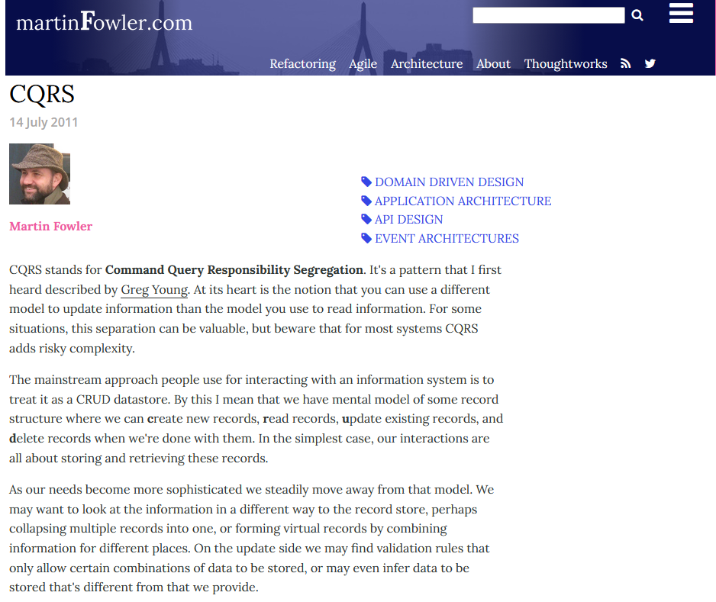
https://martinfowler.com/bliki/CQRS.html

Slide 110
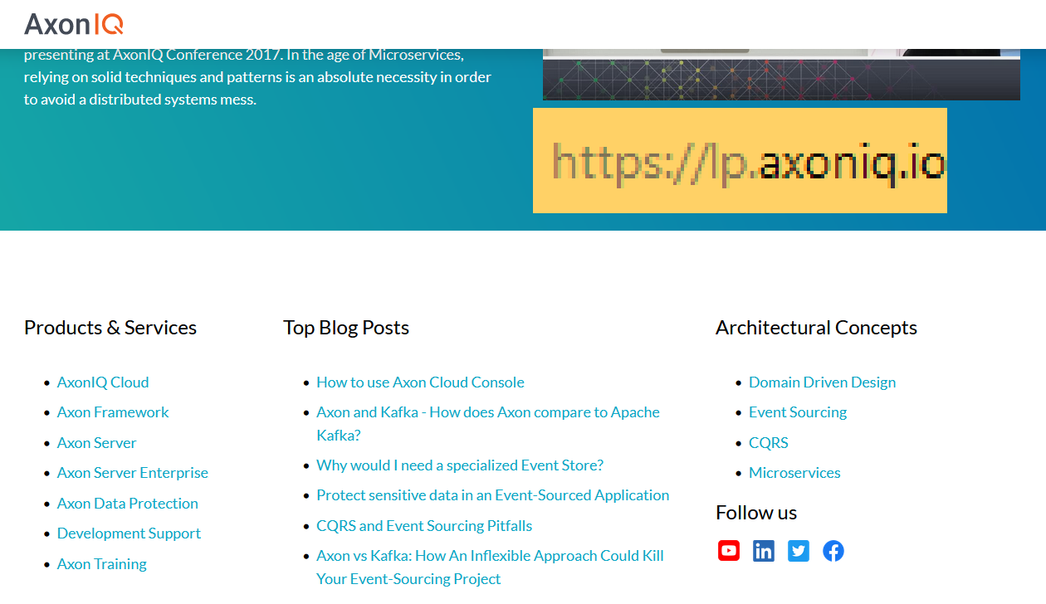

Slide 111
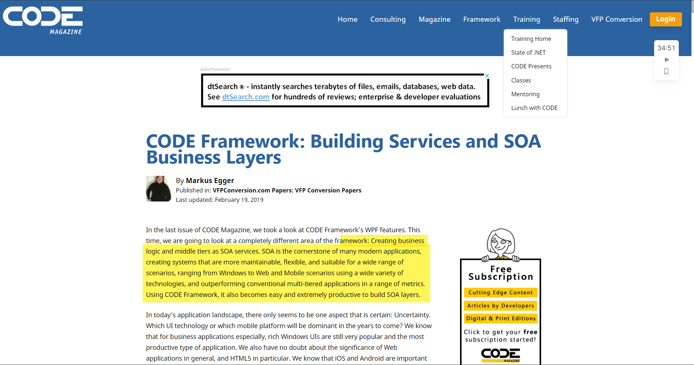
https://www.codemag.com/article/1203061/CODE-Framework-Building-Services-and-SOA-Business-Layers

Slide 112
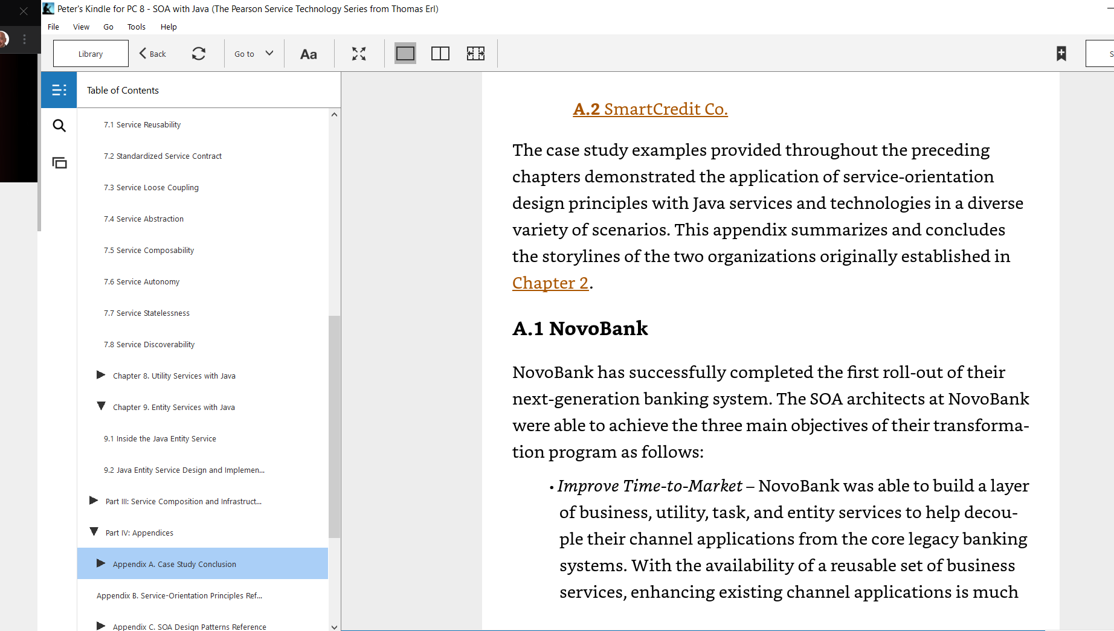
A Case Study of Java SOA:

Slide 113
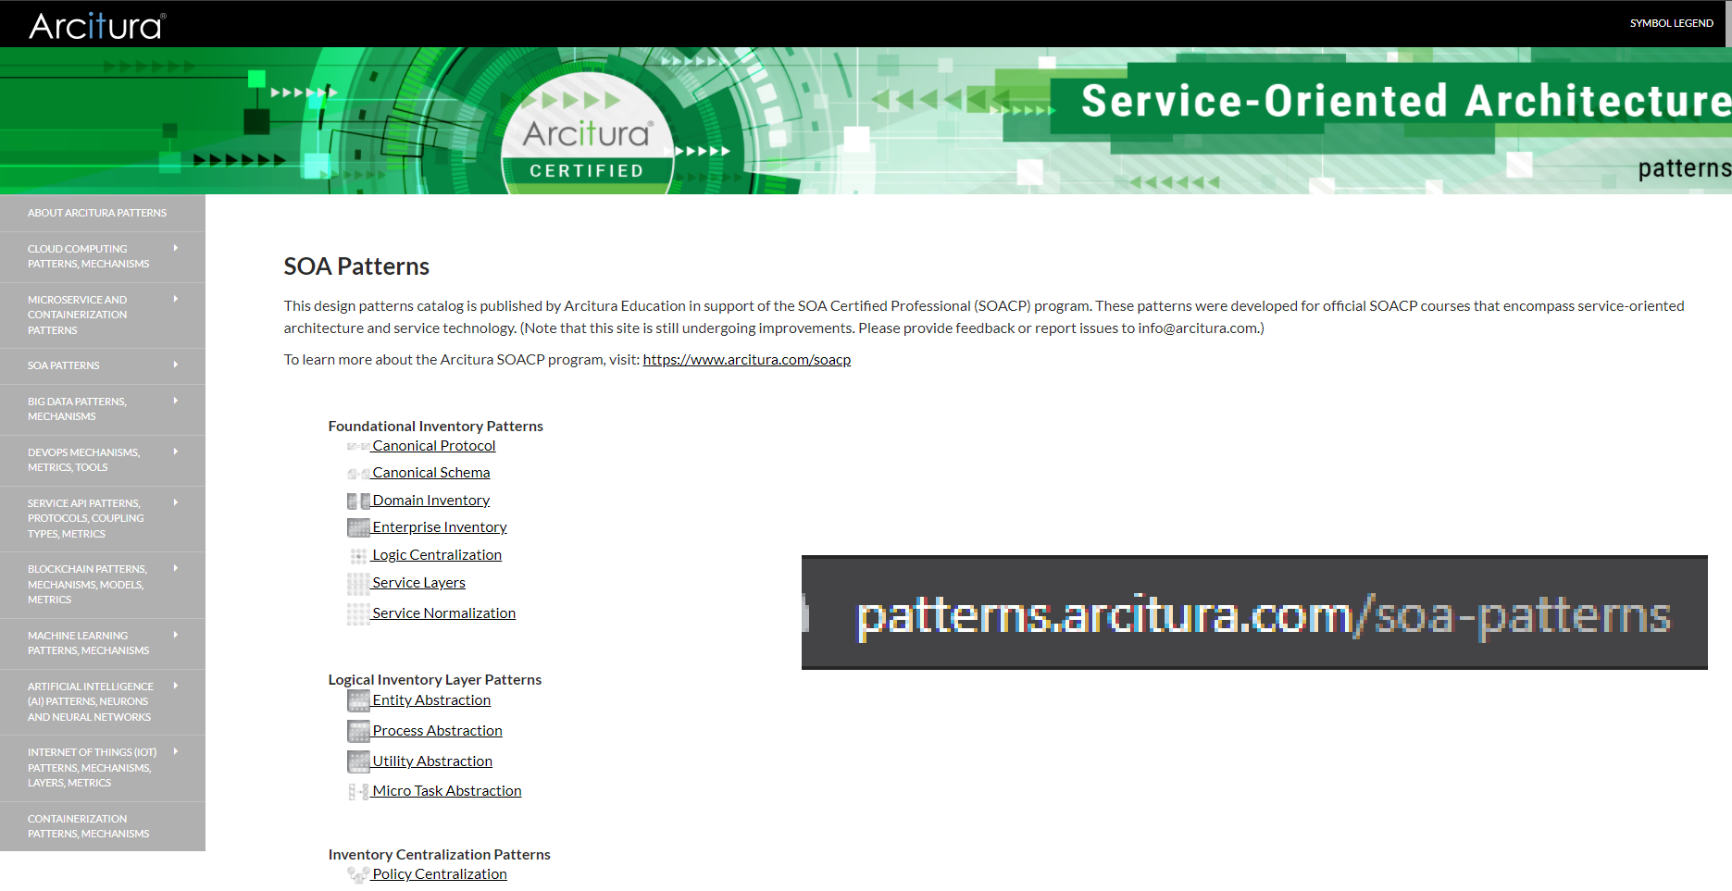

Slide 114
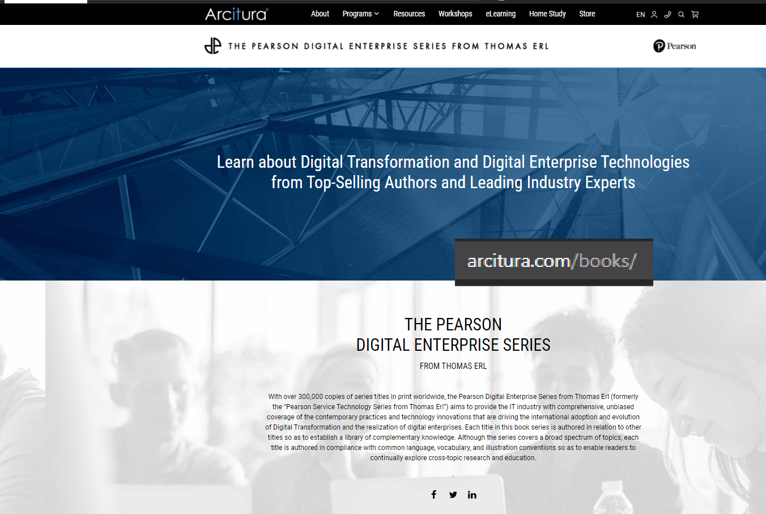

Slide 115
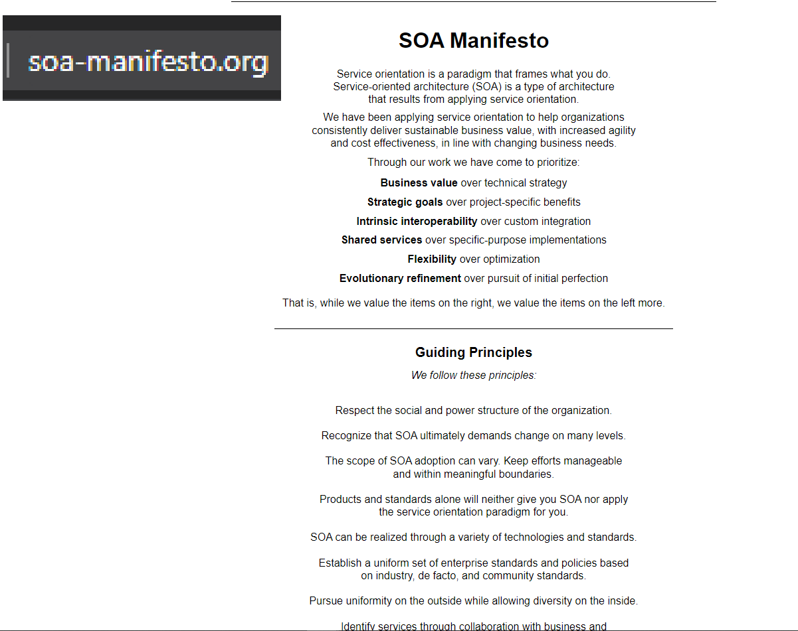

Slide 116
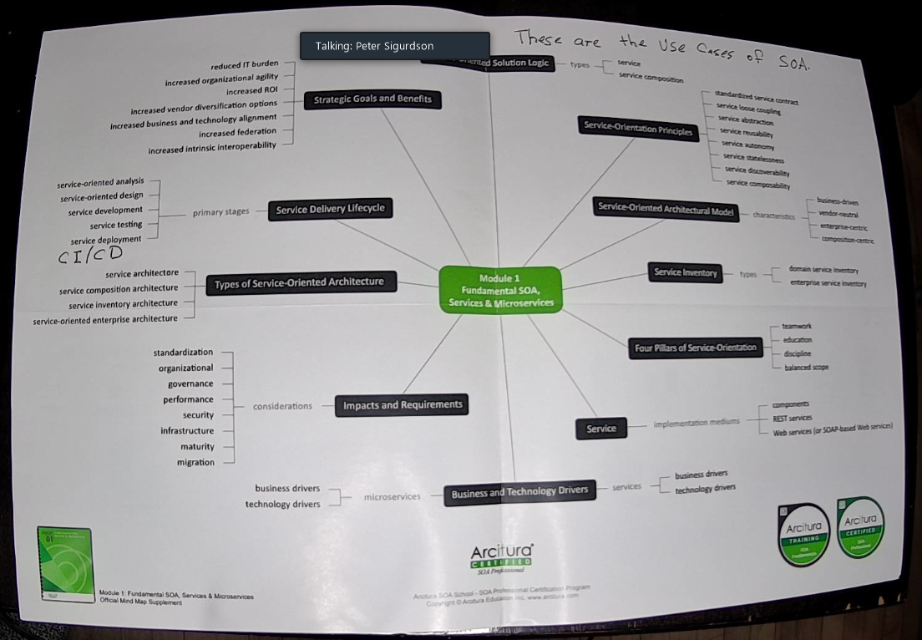

Slide 117
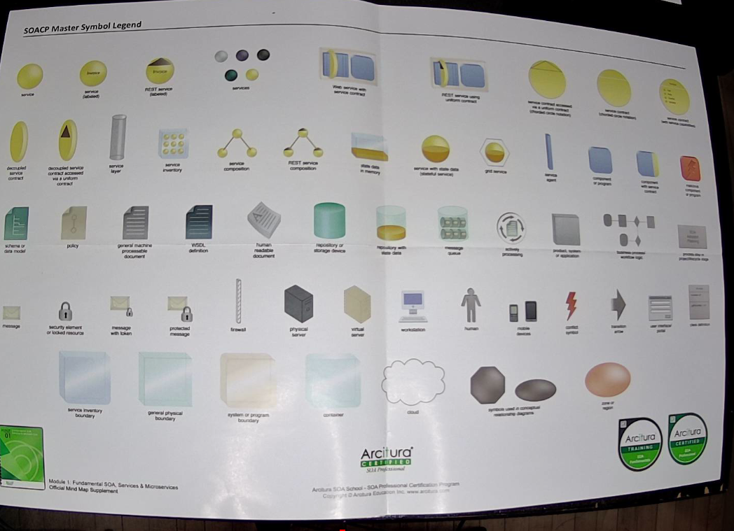

Slide 118
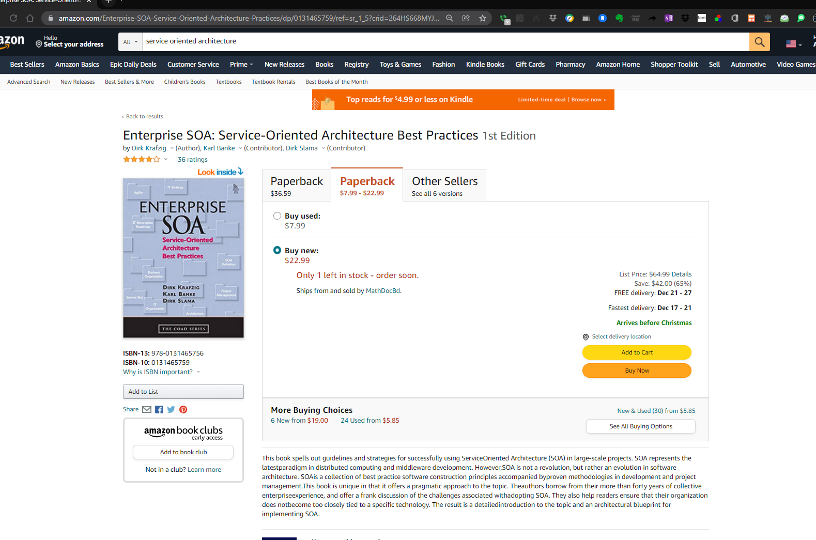


Slide 119
https://www.arcitura.com/soa-school/

Slide 120
How to build a service-oriented architecture
What are the use cases (SOA Value Checklist) of the SOA?
https://www.cleverism.com/how-to-build-service-oriented-architecture-soa/
An architecture is a set of components (Java Classes) that implements a set of business rules
Compare SOA to the old way of Code Oriented Architecture
In a COA: the business rules and algorithms are poured in the cement of how the code is written in the CONTROLLER of Model-View-Controller
In SOA: The Business Rules are encoded in the System as TEXT DESCRIPTIONS in the Model. The Model now serves Data AND Business Rules.
The mechanism that allows us to store Business Processes in a Database is BPM Notation, and Business Process Execution Language. These are Notational Languages, just like UML is a Notational Language. Because they are text descriptions in a database (Just like SQL is text-descriptive that directs how to formulate Data Results from a Database), BPEL can formulate the flow of execution in the SOA application, and change the flow of business processes, dynamically, at runtime, under program control.

Slide 121
A service-oriented architecture is:
A set of behavioral contracts that control how the Java Classes that make up the Application, interact and provide business services in the form of how the Methods are being called.
These behavioral contracts ARE the Use Cases, also known as the SOA Value Checklist or SOA value proposition.

Slide 122
Service-Oriented Architecture
A SOA is written in Java. Java was intended from the beginning to be an expressive Framework in which to develop Distributed Systems/Architectures.
In SOA, you have Java Objects living in different JVMs on hosts connected by TCP/IP (TCP pipe): SOA works by Java Objects doing Remote Method Invocation on Java Objects living in other JVMs. Even before Java WS and SOAP, CORBA/RMI was doing this.
Addressing: We need to find that other JVM Host: WSDL (WSDL is like IP in TCP/IP): What is the Platform upon which I am seeking addresses on? What is the substructure that our Java/SOAP objects are living on – that lets them connect and communicate? The Enterprise Service Bus IS the SOA Runtime Engine: the Java WS Spring Framework.
How am I going to send a JAVA OBJECT over a TCP Pipe? I put the Java Object into a special envelope called a SOAP Envelope. (SOAP is like the TCP Frame in TCP/IP)
Java classes: have methods
Services => Just method calls on your Java Classes
https://app.knowmia.com/oBHo Making SOA Architectures
https://app.knowmia.com/Zj5R Programming the simple Servlet (Just Remote Method Invocation)

Slide 123
An SOA Component is:
A Java Class in which the METHODS deliver the Processes of the Business Domain.

Slide 124
Enterprise Service Bus
The SOA Runtime (Java Program): Spring WS framework, in which the Java Objects that generate the services are contained and within which they Operate:
Student Exercise:
Create a simple MVP SOA Application
An SOA Application is just a Java Application that delivers the Use Cases of Service Oriented Architecture
What are the Use Cases of Service Oriented Architecture?

Slide 125

The SOA Business objects that we are building when we do EAI: are just Java Objects that we wrap around business processes.
These B.O.’s must communicate.
The ESB is the set of connecting “wires” that enables these BO SOA components to communicate.

Slide 126
Train yourself to think about the following question:
What is it that is making things happen?
How are the SOA Components communicating?
Because they are Java Components: Therefore they operate in a Java Virtual Machine. To make a SOAP Application, we need a JWS Java Web Services Runtime. So our JVM will load and run this JWS framework in the parent Java Virtual Machine.

Slide 127
Costs of Technical Debt:
Lose of ability to adapt to and optimize our response to changes to business and market conditions and customer demand.
Stiffness and weakness in our IT Applications that prevents being able to expand, scale, and integrate our Applications.

Slide 128


Slide 129


Slide 130
What is an XML file: Once you understand XML you will understand SOAP, because SOAP is just an XML file (at least: in terms of HOW we describe it)
A description of some data
Consider the example of a HTML Page (html is a subset of XML)
How does an XML File (which is the SOAP wrapper) describe a Java Class as a Web Service?
What does an XML file consist of?
A series of DATA ELEMENTS contained in angle brackets <>
The schema is definer that tells programmers what to do, in their code, when specified directives are encountered
Example: http://www.w3.org/2001/XMLSchema-instance

Slide 131


Slide 132


Slide 133
As agile software developers and software project managers: what are the 2 factors that drive change / improvement?
The Agile Value Chain
DEVELOPERS
We learn more about the Business Domain/ about what it really is that we SHOULD be doing
Due to the dynamic of pair programming: developers learn the business; users learn the technology
Users we are developing the IT system for
We learn more about the technology we are using: maybe better technologies become available
You need to learn how Joe Public (Avatar) is going to experience my product, and how they would like it to work.
How does the public, the final end user, experience our product.

Slide 134
The Enterprise can be viewed as:
Business Technology hardware platform DOMAIN
Business Operations DOMAIN: Goals and outcomes of the BUSINESS
SOA Value Chain happens here:

Slide 135
Value deliveries of Service Oriented Architecture Solutions:
Level 1: Achieve the Alignment of the DEVOPS platform (computer hardware) with Business Goals and Requirements.
Level 2: Optimize, squeeze out every drop of value we can get from the Platform: {The Technology, Information about our customers and the Business Marketplace, “soft knowledge” – create a repository of all the information that people have in the heads which may not be written down.}
Level 3: The highest value goal of SOA is: be able to change the way the business processes execute in real time according to customer and marketplace demand.
The tapestry of threads can self-modify dynamically, autonomously in real time
Our JSON data MODEL can self-modify dynamically, autonomously in real time
How SOA makes our Level 3 dynamic changing of business processes at runtime work:

Slide 136



Slide 137


Slide 138

Every element of the SOA Value Checklist is there because, this was the world of computing by the 1990s.
Proprietary data and hardware formats
{SOA wants open standards}
Lack of ability for companies to create data and service sharing across their networks
{Companies want the ability to easily communicate with customers and other companies}

Slide 139


Slide 140
What is the problem:

Slide 141
The 5 Steps to building SOLID Applications
Extreme programming says: Take a Test-First Approach: Write TESTS first and instruct your programmers to write their code to make the TESTS Pass
Document your Application right from the start with lots of comments and pseudocode
Create and maintain UML diagrams
Use meaningful data field and method names (these come out of your Use Cases in your Unified Process Analysis)
The benefit = Your code will be maintainable and extendable.

Slide 142
The 5 Steps to building SOLID Applications
Take a test first mindset
Forward Generate your Java Code from UML
Create your Application’s Document from the start by liberal use of Comments and Pseudo Code
Meaningful Data Field and Method Names

Slide 143


Slide 144
The basic mechanics of Programming:
Data Structures
Database, or programming data structures provided by the Language.
Look for ways to let the Data Structures go most of the work for you.
Algorithms:
Implementing sets of rules to deliver business processes in software code
We are working in Program Space.
Here in Program Space, you are working with “volatile variables”.
Set of instructions that deliver our Requirement.
Business Domain: The business processes that run the business.
You write code implementing algorithms to deliver the requirements of the DOMAIN.
Model View Controller Design Pattern of the Web Application
3 Tier Application
All of this lives in the JRE of the SERVER
J2EE jar file provides the methods
User with Web Browser:
Sends URL
MODEL: Data Store: Lives outside of your program. Persists data between runs of the program.
Controller: Java code you write to implement your Algorithms.
Web Server
URL
VIEW: HTML PAGE: Point of interaction with user
SQL Query
HTTP Stream living in a TCP PIPE
Send back a result set as a Java Collection Object
TEXT/HTML
OBJECTS/
SOAP
Rich Internet Application

Slide 145
How anonymous objects are stored in memory
Everything is an OBJECT
What is an OBJECT?
A location in Memory
Student s = new Student();
Ask does this statement allocate memory? Student s NO
But this statement DOES allocate memory: Student s = new Student()
If I do not save that generated memory location to a VARIABLE…
Java Runtime Environment has a background process called the Garbage Collection Process. A certain times, object references which have lost visibility, or they have gone out of scope to a running process thread, are deleted (garbage collected).

Slide 146
When you are programming: You need to have 2 levels of thinking going on at the same time:
Computational Thinking: Learn to look at the Problem the way that the computer algorithm will be able to deal with it.
The thinking mode here is
Functional Decomposition
You need to think about the algorithm and the problem you are solving to deliver the result.
You need to structure the ELEMENTS of your Application to obey / work within the requirements and the mechanics and the Data Plumbing required by the Rules of your Programming Environment.

Slide 147


Slide 148
What is a Web Service?
A more meaningful name would be: web-DELIVERED services
We are NOT getting services from the WEB: We are getting services from METHOD CALLS!
Getting Services in JWS means doing RMI Remote Method Invocation
A service in a programming language context = calling a METHOD
Getting a SERVICE from your SOA Java Web Application MEANS calling a method on an object that lives in another JVM.
You are used to working in 1 JRE/ 1 JVM: The concept of Java Web Services IS we have many NODES (end points) in our SOA topology.
NODE = an ENDPOINT. A computer (host) running some Java Application code.

Slide 149


Slide 150


Slide 151
Summary of Assignments:
https://docs.google.com/spreadsheets/d/1YKxbCjbR5l6-fcl7QE8rswSOEUghBLACuAllK2qjPOo/edit?usp=sharing summary of assignments

Slide 152


Slide 153
What is a Web Service?
A more meaningful name would be: web-DELIVERED services
We are NOT getting services from the WEB: We are getting services from METHOD CALLS!
Getting Services in JWS means doing RMI Remote Method Invocation
A service in a programming language context = calling a METHOD
Getting a SERVICE from your SOA Java Web Application MEANS calling a method on an object that lives in another JVM.
You are used to working in 1 JRE/ 1 JVM: The concept of Java Web Services IS we have many NODES (end points) in our SOA topology.
NODE = an ENDPOINT. A computer (host) running some Java Application code.

Slide 154
Java Web Services:
Up to now: We have been writing Desktop Java Applications:
Our code lives in the Java Virtual Machine, created by the Java Runtime Environment: java.exe
I cannot run the run the Java Application on your computer: Your Java Virtual Machine is inaccessible without access to your keyboard
What we want is to make Java “Enterprise Edition” J2EE web services applications:
Difference between a Java Web Services Application and a Java Desktop Application is:
A Java Web Services application can be run by anyone on the Internet by pointing the URL in their browser at the IP Address of your computer (and the PORT that your application is running on)

Slide 155
Java Web Services:
A simple starter exercise:
We will setup a local HTTP Server: https://www.apachefriends.org/index.html
Key differences between Java Desktop Application and Java Web Services Application:
In J2EE (Java version 2 Enterprise Edition): we are putting an HTTP server INSIDE OUR APPLICATION
Really: We are installing the J2EE.jar file in our Application: our Web HTTP server is being setup by the J2EE Runtime we get from the J2EE framework: J2EE.jar

Slide 156
Visual Studio Code:
https://code.visualstudio.com/download
Course Material on TCP IP Networking:
https://www.dropbox.com/sh/ejy0joisa00ktoi/AAAB5VS307q7o8TiMzOzpIF5a?dl=0
Read the TCP IP Guide.pdf

Slide 157

Illustrate the concept of an HTTP Server
IN JWS: that HTTP server will be provided right within our Program Code
The good news is:
We do not need to write the HTTP server by ourself:
We are going to include the J2EE.jar file in our classpath
This J2EE framework will give us a Java Web Application Server

Slide 158
Java Web Services:
We have seen how to receive input from the console and send the response back to the console (System.out.println)
Now the new thing with J2EE is:
Accepting input from a web form
Sending the reply back to the requesting web browser
Our user is no longer operating our program from the local machine: But is on the other end of an End Point somewhere else on the Internet: All they need to know is the IP Address of our computer, and what port to point to. {And optionally, user id and password}

Slide 159
In Java, everything is an Object
There is a top level object called Object (The root of all visibility)
https://docs.oracle.com/javase/7/docs/api/java/lang/Object.html

Slide 160


Slide 161
The Service Oriented Architecture Value Proposition
Why do we build SOA architectures
How do they help the Business:

Slide 162


Slide 163


Slide 164
Present to the Job Interviewer your short, concise description of HOW TO PLATFORMIZE the Enterprise. That is: How to design a Java Application to realize Enterprise Application Integration:

Slide 165
Enterprises Architectures live in very large, multi-national companies.
Spans many Geographies
Spans many different Lines of Business.

Slide 166
Peter's Book on SOA:
https://www.dropbox.com/s/5c5wx51tuz43j0s/SOA%20Enterprise%20Service%20Bus%20implementation%20with%20Spring%20Boot.docx?dl=0

Slide 167
Legacy System Integration
Your Job is the build the Plan and the Code to integrate numerous disparate, heterogeneous, legacy computer systems.

Slide 168
Developing the software plan with Unified Process project management methodology and Agile Software Engineering Methodology
https://www.dropbox.com/sh/ua6yppm87wgklz0/AADfgAD8MRw-yfOQk-pFKMrRa?dl=0
https://www.dropbox.com/s/sgcn3ruho3gxu1p/Agile%20Project%20Management%20with%20Use%20Cases%20and%20UML%20to%20do%20Unified%20Process%202.pptx?dl=0
Watch the Video!!!!

Slide 169

At the end of this course, you will be able to pass the OMG UML Certification Exam:

Slide 170
The basic thing which you are learning in this course is to learn how to design.
This requires a substantial amount of technical creativity and is more of an art than a science.
How do you teach somebody how to design something that's technically creative?
How do you teach someone to write a 100 Million Dollar Movie Script?
I will role model how I come up with Designs. You need to learn the knack of how to do it!

Slide 171
To start with: What is an API?
A PUBLIC/Published/Doucment set of methods, functions and procedures allowing the creation of applications that access the features or data of an operating system, application, or other service.
It is a guarantee that if you use my program and you use my method and give it the correct input parameters: It will give the correct result!

Slide 172
How do we web enable COBOL or any of the old legacy software which is running all of the world’s big companies?
Model View Controller
Web Services APIs
View : can be a WEB PAGE/html
IN MVC, we can provide a gateway / portal to old legacy code by using a MEDIATOR PROGRAM to invoke a method on the legacy code, grab the result, wrap it up in HTML, and present the answer back to the user via a WEB INTERFACE
How do APIs help us build the Web Application?
Remember the definition of ROUTING!
We can create a METHOD in our Controller program such that when the user INVOKES our method with a routing VERB at the end of the URL: that URL will cause a specific method in our program to be run!
This is doing API Integration into our Node.JS application.
Mediator Pattern: It is program written in NODE.js which invokes methods on the old legacy code = presents the result back as HTML
Controller: A place for your ALGORITHM – How to deal with 50 year old COBOL CODE
MODEL: magnetic tape in the old days

Slide 173

The Model: A Place for Your Stuff
The View is the HTML / or mobile app markup code: It SHOW data to the user and gives the user CONTROLS to enter information back into the application!
The Controller is the CODE (for loops/while loops, if then, objects) which you use to implement your ALGORITHM. This is where the business rules are implements. This is where the application Comes To Life.
The model is where you put all your STUFF: meaning your Business Data and Business RULES.
The controller has MEMORY VARIABLES – They are Volatile MEMORY – because when the program ends, the data states of all those objects and variables goes away. They are all gone!
The database / or other storage mechanism (file system for example) is the PERSISTANCE LAYER that lets us keep the Data State of the Application between “runs” of the program.

Slide 174

UML is one of our primary design tools in Enterprise Modeling:
Unified Modeling Language is a Notational System
We write diagrammatic entities which represent the Elements of the Software System that we are modeling.
Purpose is plan:
How our objects will communicate with each other (Because ultimately our UML ENTITIES become Java Objects)
Benefit: Plan the construction of Java Objects before we start coding
The Power of UML is that it lets us do things like this!

Slide 175
Describe what the Enterprise is - and how do we "model" it?
The Enterprise is the Business
It is the collection of all the:
Processes
Databases
Routers
Networking
Servers
Point of Interface terminals
That makes the business work!
We model it with UML – see previous slide!

Slide 176

This is also applicable to Cloud Application Development.

Slide 177
What do we mean by remote method invocation?
Desktop Application:
Everything happening in 1 JVM
Cloud Application:
Multiple HOSTS
We call methods on objects in other JVMS:
Connected by TCP Pipe

Slide 178
Describe how you would model an external resource like a database in your Software Architectural Diagram?
Write a Mediator Class as a Wrapper around your RESOURCE like the Database.
That class you wrote will provide API Methods. Those methods will actuate “read” or “write” the database
That Mediator Class is how you model an External Resource in your UML.

Slide 179
2 primary concerns of Enterprise Modelling:
Facilitate Communication among developers.
Facilitate Communication with Clients.

Slide 180
Connecting to a Database in Code. Also: How do we “model” that connection in UML:
IP Address configuration to connect to the Database
Some application code
MS SQL Server
Application Program running on a Host Computer
You have a “DRIVER” program which makes available to the OS the APIs of the Database.
OBDC Connector configured in the Operating System.
My Application code written in Java:
JNDI : Java Native Device Interface Code
Connector to my database

Slide 181

The Monolith vs Microservices
The basis of the SERVICE ORIENTED Architecture
Code oriented architectures
Architecture was poured in cement
Eg: MVC

Slide 182
Goals of SOA:
To allow dynamic, programmatically controlled updates and changes to business process delivery and execution according to the requirements of:
Users
Customers
Business environment

Slide 183

Read this book to develop your Business Acumen:
The purpose of the Enterprise Architecture is to give us a TOOL SET to use all the STUFF available in our Enterprise:

Slide 184
Central Focus of this Course
Our Big Why in Enterprise Application Integration is to Platformize the Enterprise
The Enterprise is THE SET of all the:
Business processes (described as Business Process Modeler Notation Language / BPEL: Business Process Execution Language) that make the business work.
You have a good methodology to deliver on the goals of the SOA Value Framework which is: (The TOOL that makes SOA happen:) Unified Process: https://www.dropbox.com/sh/ua6yppm87wgklz0/AADfgAD8MRw-yfOQk-pFKMrRa?dl=0

Slide 185

What is different about Service Oriented Architectures vs the old school Code Oriented Architectures?

Slide 186

Discuss the UML Concept of the Equivalence Principle:

Slide 187


Slide 188


Slide 189
Discuss the UML Concept of the Data-Object Equivalence Principle:
An important consequence of this is that you should look for ways to push as much as possible of your algorithm into the Data Store and let the data store do the heavy lifting for you.

Slide 190
Last week we talked A2:
I issued Part 1: writing the Java Code
NOW: we will learn how to SOA – enable your code

Slide 191
Information Architecture
Business concerns
Profit, Revenue
Controlling Costs
Scheduling
Get the product delivered on time
Enterprise Application Integration
IT Infrastructure Project Management
System Design
Since you are looking for a job:
Find a job in which they will pay for your training and grow you into this role

Slide 192
Enterprise Systems: Problems
… but there are problems with ES
Lack of agility
Inefficiency in enterprise software development that ends up costing too much
Do not quickly adapt to global economy changes and market changes
Business processes underlie constant change
Initial change cannot handle subsequent multiple change requests causing the system to deteriorate dramatically
All these factors are concerns that we fix with the SOA architecture and the Methodology of Unified Process that implements the SOA Architecture.

Slide 193
The technology is half of the Equation of SOA
The other half is the Human/Cultural Elements:
People’s understandings of what to do, how to do it.
Varying Educational Levels.

Slide 194

Your future duties and responsibilities:
As a Project Manager on our team, you will be working on multiple engagements of various sizes. This role will require strong communication and interaction with both internal and external clients.
• Leading cross function teams across multiple concurrent initiatives of various scales.
• Work collaboratively with the management teams in GTO and GTA in both the Transition and Project Portfolio Programs.
• Plan, manage, and report weekly on the status of engagements.
• Participate in daily scrums for the Transition and Project Portfolio.
• Ensure standard CGI PM processes for resource, risk and change management are applied across all projects.
• Perform risk assessment to ensure project risks are identified and mitigated appropriately.
• Confidently coordinate the communication and escalation of issues both internally and externally.
• Manage project documentation , status reports, client/stakeholder communications
Position Description:
Join our Global Technology Operations Business Unit!
We are looking for a Project Manager to support transitional projects within the team.
Who you are:
• Minimum of 7+ years of Project Management experience on IT infrastructure engagements. • Experience in the public sector would be an asset.
• Strong technical skills that would complement the role as a PM.
• Demonstrated ability to be collaborative with various stakeholders while keeping CGI interests as their primary focus.
Required qualifications to be successful in this role:
Essential Qualifications
• Education: Minimum Bachelor Degree in Computer Science or Business Administration/Project Management.
• Certification: Project Management institute (PMI) is preferred.
• Project Management experience with varying scales of Infrastructure engagements.
• Solid understanding of Project financials (i.e. Budget, Forecast, Actual tracking etc)
• Excellent verbal and written communications skills and conduct presentation to leadership teams.
• Strong background in risk management and mitigation.
Qualifications:
• Independent worker that requires little supervision beyond initial scope expectation and transfer of requirement.
• Knowledge of security, network, infrastructure experience and workflow would be an asset
• Familiarity of managing Vendor to Vendor/Vendor to Client transitions.
Skills:
Infrastructure architecture
Project Management
Transition management

Slide 195
The major complaint I hear about new graduates from employers.
is not that they don't have experience
they know that you are new graduates : if they wanted somebody with experience they wouldn't be talking to you
if they tell you that you don't have experience it is because they are trying to be gentle and they don't want to hurt your feelings by telling you the truth :
The real complaint we hear about new graduates is that when the interviewer talks to them to discern their insight into the basic technologies that they have studied at school : it quickly becomes clear that the student has absolutely no idea.
Maybe they memorized the textbook and maybe they got good grades on the tests but they actually do not have insight into how the technology works .
Employers will pay to train a new graduate who has some demonstrated genuine interest in the technology or the field or the kind of work : but if you evince being totally clueless: They are not going to waste their money on you ,

Slide 196

The basic setup for Java Web Services and RESTful Applications
It starts with the Web Browser being able to send information back to the SERVER
Example of a basic HTML FORM:
HTTP Server
Key Value Pair
http://localhost:3300/program1.js?customername=Peter&aButton=Submit
Forms can send only TEXT over the HTTP protocol connection
To create a Rich Client Application, we must convey Java OBJECTS between client an Server: this is done with REST and serialization of Java Objects: Java Objects can be conveyed between client and server by serializing them into text strings which can transmit on the Http Connection

Slide 197
Introducing REST
Representational State Transfer is a Way of Conveying Java Object State between 2 end points
A Java Object is STATE: meaning the values of each of the Data Attributes
(METHODs live in the Class: Data lives in the OBJECT)
Serialization: freeze dry a Java Object: we turn it into a String of TEXT
Because our Java Object: with all of its data attributes and state: now lives in a TEXT Format, we can now convey that Java Object across the network between end points: when the serialized Java Object is received on the receiving End Point: we deserialize it: we “add the water back” and turn the serialized text string back into a Java Object with all of its STATE restored to the original version when it was serialized.

Slide 198
For next week: Install Apache HTTP Server
Download from https://www.apachefriends.org/index.html
Video instructions: https://youtu.be/4w27DveigS0
For now I will demonstrate how to setup the simplest web application using FORMs
This will be the lead up to making Java REST applications: these will run on an HTTP Server and Client, so you still need these skills:

Slide 199
What is a PLATFORM
A set of APIs which wrap around the classes and the databases, web server, and other external resources, to make the data and business processes accessible via a Web or Mobile App Interface
Basic hardware and software (DEVOPS) upon which make:
applications
Data access
Business Processes
Available to authorized users
We put SOAP Wrappers around our Java Classes to make the METHODS of those classes available in the Enterprise, by turning them into SOAP APIs. This is the simplest definition of what SOAP is.
The Platform is the SET of APIs that provide access to the DATA and SERVICEs (Methods) of the elements in our platform.

Slide 200
How does SOA drive / deliver business value?
By providing easy access to and discovery of the:
SERVICES
DATA
Business Processes
Of the Enterprise

Slide 201
What does a USE CASE look like ? What does a business process look like?
Use case could be thought of as a graphical representation of the requirements gathered during the previous stages of unified process modelling. Business process essentially could be a series of activities which take in an input process it and produces an output (which could be a business value in this case) example could be accounting process
Use Case is a semantic wrapper of Business Process
Semantic means “meaning”, “intention”
Use Case = The Goal PLUS THE Implementation of something we are trying to do in the Business.

Slide 202
What does a USE CASE look like => what does a business process look like?

Slide 203
What does the CONTROLLER do in MVC
Acts as an interface between the front end and the backend database
It is the code we write to implement/realize the algorithms and business processes of our Application.

Slide 204
The basic thing which you are learning in this course is to learn how to design.
Step 1 in Peter’s Book of Knowledge about how to be a Software Designer:
You study your requirements and your turn them into a UML Diagram.
Unified Process promises you that if you write a properly formulated UML Diagram, you will have a completely well-documented set of requirements to write your software from.
We will now create a UML diagram to forward generate your Part 1 Java Code from.

Slide 205
In this course, we are learning to write JAX RS framework (Java Web Services) Code to automate the operation of business processes in the Enterprise
The Advantages: | The Implementation Challenges
Once we get the program working, we will save implementation costs because we don’t need to pay humans to sit and do it. Once we get the program working PROPERLY, we can be sure the process will be executed correctly. | How can we find and encode into the Informatics System the knowledge we need as inputs to our processes, as well as the “human-factor” awareness and intuition to deal with incomplete or contradictory inputs.
Where does the knowledge live, and how do we access it and encode it into a format that can be consumed and controlled by our JAX RS code?

Slide 206

IF Only we Knew what we know
One of the big goals of the SOA Paradigm is to surface, and make available everywhere, in a programmatic format, all of the “soft knowledge” that is implicit in our Organization.

Slide 207
Quick Review of Unified Process: (Agile Best Practices Guide)
It starts with gathering requirements which we do by gathering User Stories
We turn the User Stories into Use Cases // Using the technique of Lexical Analysis (https://youtu.be/DnCYcvRL9xg): As BIA business analysts: One of our big reasons for creating use cases is: Business Process Discovery
We turn the Use Cases into UML Entities. UML is a notational system. We draw boxes and lines to connect them together. The Boxes represent WHAT and WHAT ? Classes (Java), Mediators (= Java Classes that provide our connection to Databases, POI, or other external resources)
We study the UML Diagram and forward generate our Java Code from it. This is called Forward Engineering.
What is reverse engineering? Write UML diagrams from Java code

Slide 208

The purpose of creating Use Cases is to do
Business Process Discovery:
It starts by identifying ACTORS with GOALS and writing down the set of steps they do to make the goal happen. These steps are the business processes.
ACTOR: Anything external to the SUD which:
Initiates/controls the behavior of the system
Receives some value update

Slide 209
JUNE 16 Class 07
Write the Simple Java Application:
Learning outcomes:
Setting the stage to create a JAX Application
Resources: https://share.mindmanager.com/#publish/4egQjo_I43Z2rXFQm0BUzFPmsO2KT6UEwq-VF-10
TASKING 1: CREATE A CALCULATOR JAVA PROGRAM:
GOOD OO / ENCAPSULATION: STRONG USE OF METHODS (APIS) TO COMMUNICATE BETWEEN YOUR CLASSES
TASKING 2:
DESIGN THE COLLEGE ENROLLMENT SYSTEM USING UML: FORWARD GENERATE OUR JAVA APPLICATION FROM THE UML

Slide 210
The Purpose of this course:
To wire up Business Processes to run like computer programs
To Create Java Code to deliver Business Processes
Jax WS: Java Web Services is the new version of Java 2 Enterprise Edition:

Slide 211

WHY this matters:
Employers cannot find enough people with these skills to fit the demand.

Slide 212
WHAT IS THE PURPOSE OF DOING THE UML ANALYSIS AND THE TECHNOLOGY PRODUCT DESIGN?
2 main outputs:
Code
Traceability Matrix: software testing plan

Slide 213
SOA = Model View Controller Framework
BUSINESS MODEL: The topology of data and business processes that operate the Business
CONTROLLER
Implement the algorithm
Implement the Use Cases
VIEW: POI : POINT of Interaction of the User with the System
Iphone screen
HTML FORM
Data
Business Processes
How can we store business process descriptions in a database ? This is the PIVOT of SOA Value Delivery!
If we could NOT do this – We could not have SOA!
This can be done with a a sql or NO SQL db (MONGO DB)
You will probably use a MONGO d.s. to implement this.
Business Process Modeler Notation and Business Process Execution Language

Slide 214
The new approach to writing code and architecting IT Applications that enables SOA:
In this new SOA World:
We build SERVICE ORIENTED Architectures
Code Oriented Architecture:
Our algorithms, our business process flow: All the stuff that happens in the Controller partition
Is poured in Cement

Slide 215
The new approach to modeling data is: Schema-less, NO SQL databases (MONGO DB)
SQL Datastores:
Codd’s 13 Laws
Count on having a Primary Key
SQL data structures are NOT mutable (changeable) under program control.
MONGO DB:
Uses xml JSON text files to describe the data (not structures like SQL Tables)
Benefit:
You can programmatically change the way your data is stored at run time.
About 70% of designing an IT solution is designing the Data store

Slide 216
The Emerging Trend in IT Architectures is:
We implement decentralization by:
Decentralization
Use of applicable Java Design Patterns

Slide 217
The basis of an Enterprise System:
Message Queuing
Standalone Desktop Application: All the Java Classes communicate within One Operating System using IPC Inter Process Communication Sockets
What about “Distributed Systems”?
The Enterprise Catalog
Computer A
Computer B
JVM
JVM
TCP IP Network (The Internet)
Java Classes in each JVM communicate using Java Sockets.
In JAX-Rs we have many Library Classes to provide extra services such as Service Broadcasting and Discovery. (Enterprise Service and the SOA SOAP Message.

Slide 218
You should consider SOA as being analogous to TCP/IP
SOAP
Producers and Consumers discover each other through the Enterprise Service Catalog and communicate via the Enterprise Service Bus (ESB)
There are XML configuration files called WSDL Web Services Description Language which are like the IP Internet Traffic Routing Protocol in TCP/IP
Java Class
Analogous to the TCP Frame
Each Java Class in our Architecture may be a Producer or Consumer of Services

Slide 219
Event Driven Architectures
What is an EVENT
How do we capture and process an EVENT in Java Space?

Slide 220
Lab 1 Instructions:
https://www.dropbox.com/s/3sttyqtr6oi59p8/INFO-6103%20-%20Lab%201.docx?dl=0
Post questions in our Slack Room:
INVITE link to get into Slack:
https://enterprisemodelling.slack.com/archives/C023C1UE206

Slide 221
The Application of UML to Enterprise Modelling
Unified Modeling Language is a notational system that gives us a tool box to:
Describe (“as is” system)
Prescribe (“to be” system)
If you are in a job where the company has a “stove pipe”, you create UML diagrams to describe all the components in the architecture now
You will also use the Unified Process Methodologies to interview stakeholders, get their user stories.
Describe how you would model an external resource like a database in your Software Architectural Diagram?
We make a UML Entity like a Database Mediator that has the connection to the Database and provides METHODS to send SQL statements to the database receives result sets back (as a collection objection) and we iterate over that collection to pull off each record of data and process it.

Slide 222

Monday May 31 : Day 05
Checkpoint on where we are in the course:

Slide 223
What is SOA, or service-oriented architecture?
SOA, or service-oriented architecture, defines a way to make software components reusable and interoperable via service interfaces. Services use common interface standards and an architectural pattern so they can be rapidly incorporated into new applications. This removes tasks from the application developer who previously redeveloped or duplicated existing functionality or had to know how to connect or provide interoperability with existing functions.
Each service in an SOA embodies the code and data required to execute a complete, discrete business function (e.g. checking a customer’s credit, calculating a monthly loan payment, or processing a mortgage application). The service interfaces provide loose coupling, meaning they can be called with little or no knowledge of how the service is implemented underneath, reducing the dependencies between applications.

Slide 224
What is SOA, or service-oriented architecture?
This interface is a service contract between the service provider and service consumer. Applications behind the service interface can be written in Java, Microsoft .Net, Cobol or any other programming language, supplied as packaged software applications by a vendor (e.g., SAP), SaaS applications (e.g., Salesforce CRM), or obtained as open source applications. Service interfaces are frequently defined using Web Service Definition Language (WSDL) which is a standard tag structure based on xml (extensible markup language).
The services are exposed using standard network protocols—such as SOAP (simple object access protocol)/HTTP or Restful HTTP (JSON/HTTP)—to send requests to read or change data. Service governance controls the lifecycle for development and at the appropriate stage the services are published in a registry that enables developers to quickly find them and reuse them to assemble new applications or business processes.

Slide 225
What is SOA, or service-oriented architecture?
These services can be built from scratch but are often created by exposing functions from legacy systems of record as service interfaces.
In this way, SOA represents an important stage in the evolution of application development and integration over the last few decades. Before SOA emerged in the late 1990s, connecting an application to data or functionality housed in another system required complex point-to-point integration—integration that developers had to recreate, in part or whole, for each new development project. Exposing those functions through SOA services allowed the developer to simply reuse the existing capability and connect through the SOA ESB architecture .

Slide 226
microservices architecture
Note that although SOA, and the more recent microservices architecture, share many words in common(i.e. "service" and "architecture"),

Slide 227
What is an ESB?
An ESB, or enterprise service bus, is an architectural pattern whereby a centralized software component framework uses to create integrations between applications.
It performs transformations of data models, handles connectivity/messaging, performs routing, converts communication protocols and potentially manages the composition of multiple requests. The ESB can make these integrations and transformations available as a service interface for reuse by new applications. The ESB pattern is typically implemented using a specially designed integration runtime and toolset that ensures the best possible productivity.
It is possible to implement an SOA without an ESB, but this would be equivalent to just having a bunch of services. Each application owner would need to directly connect to any service it needs and perform the necessary data transformations to meet each of the service interfaces. This is a lot of work (even if the interfaces are reusable) and creates a significant maintenance challenges in the future as each connection is point to point.
In fact, ESBs were, originally, considered such a de facto element of any SOA implementation that the two terms {Service Adapters and Enterprise Service Bus} are sometimes used as synonyms, creating confusion.

Slide 228
Paradigm for The SOA and the ESB
SOA
Technology and a Business Paradigm
ESB
Connection topology/protocol

Slide 229
Heuristics to identify whether a Enterprise Application Integration is a GOOD EAI!
2 qualities of a Good Java Application:
Loose Coupling : easy to connect your classes with other classes
High Cohesion : stickiness
1 class does one JOB
All the members of that class (data attributes and methods) are focused on delivering 1 JOB

Slide 230
Benefits of SOA
Compared to the architectures that preceded it, SOA offered significant benefits to the enterprise:
Greater business agility; faster time to market: Reusability is key. The efficiency of assembling applications from reusable services - i.e. building blocks, rather than rewriting and reintegrating with every new development project, enables developers to build applications much more quickly in response to new business opportunities. The service oriented architectural approach supports scenarios for application integration, data integration, and service orchestration style automation of business processes or workflows. This speeds software design and software development by enabling developers to spend dramatically less time integrating and much more time focusing on delivering and improving their applications.
Ability to leverage legacy functionality in new markets: A well-crafted SOA enables developers to easily take functionality ‘locked’ in one computing platform or environment and extend it to new environments and markets. For example, many companies have used SOA to expose functionality from mainframe-based financial systems to new web applications, enabling their customers to serve themselves to processes and information previously accessible only through direct interaction with the company’s employees or business partners.
Improved collaboration between business and IT: In an SOA, services can be defined in business terms (e.g., ‘generate insurance quote’ or ‘calculate capital equipment ROI’). This enables business analysts to work more effectively with developers on important insights—such as the scope of a business process defined using services or the business implications of changing a process—that can lead to a better result.

Slide 231
SOA Examples
By 2010, SOA implementations were going full steam at leading companies in virtually every industry. For example:
Delaware Electric turned to SOA to integrate systems that previously did not talk to each other, resulting in development efficiencies that helped the organization stay solvent during a five-year, state-mandated freeze on electric rates.
Cisco adopted SOA to make sure its product ordering experience was consistent across all products and channels by exposing ordering processes as services that Cisco’s divisions, acquisitions, and business partners could incorporate into their websites.
Independence Blue Cross (IBC) of Philadelphia implemented an SOA to ensure that the different constituents dealing with patient data—IBC customer service agents, physicians’ offices, IBC web site users—were working with the same data source (a ‘single source of truth’).

Slide 232
SOA vs. microservices
Experts have filled a few thousand print and digital pages comparing SOA and microservices, and defining the subtleties of their relationship to one another. For the purposes of this article, the chief differences between the two are the coupling of components and scope of use:
SOA is an integration architectural style and an enterprise-wide concept. It enables existing applications to be exposed over loosely-coupled interfaces, each corresponding to a business function, that enables applications in one part of an extended enterprise to reuse functionality in other applications.
Microservices architecture is an application architectural style and an application-scoped concept. It enables the internals of a single application to be broken up into small pieces that can be independently changed, scaled, and administered. It does not define how applications talk to one another—for that we are back to the enterprise scope of the service interfaces provided by SOA.

Slide 233
SOA vs. microservices
Microservices architecture emerged and gained steam with the rises of virtualization, cloud computing, Agile development practices, and DevOps. Most of the advantages of microservices in these contexts arise from the decoupling of the components, which simplifies and improves the following:
Developer agility and productivity: Microservices enable developers to incorporate new technologies to one part of the application without affecting the rest of the application. Any component can be modified, tested, and deployed independently of the others, which speeds iteration cycles.
Scalability: Microservices can take maximum advantage of cloud scalability—any component can be scaled independently of the others for the fastest possible response to workload demands and the most efficient use of computing resources.
Resilience: Again, thanks to decoupling, the failure of one microservice does not impact the others. And each microservice can perform to its own availability requirements without staking the other components or the entire application to greatest common availability requirements.

Slide 234
SOA vs. microservices
In the same way that microservices architecture has the potential to bring improvements in agility, scalability, and resilience to application design, these same techniques can also be applied to integration.
This is important because, over time, the heavily centralized ESB pattern and its associated centralized team of integration specialists can become a bottleneck. Borrowing from microservices principles, we can potentially break up the ESB into a more fine-grained, decentralized integrations. This is one of the core premises behind agile integration.

Slide 235

Web Services

Slide 236

Web Services

Slide 237
The use of REST in Java Enterprise Modelling
REPRESENTATIONAL STATE TRANSFER IS THE PROTOCOL WE USE TO TRANSFER RESOURCES
CONSISTS OF URL VERBS (POST AND GET) TO REPRESENT AND TRANSFER RESOURCES
RESOURCES:
SERIALIZATION AS THE POJO TO SERIAL THE JSON STRING (MAY BE DONE WITH XML AS WELL)
BUILDING THE JAVA ENTERPRISE MODEL AMOUNTS TO CODING RESTFUL APIs TO WRITE REST SERVERS AND CLIENTS.
HOW TO USE THE JAX RS API TO IMPLEMENT A REST SERVER AND CLIENT

Slide 238

WHAT REST AND REST APIs LOOK LIKE
A restful API that represents a BOOK resource
GET retrieves resources
To retrieve a list of all the books in the BOOKSHOP application, you make a GET request to this URI and it would return a JSON representation of all the books in the bookshop
To create a BOOK, you post a body containing the JSON representation of the book you want to create to the same URI

Slide 239
The intention of the Service Oriented Architecture
We want to turn the Enterprise Architecture into a PLATFORM
Review the differences between the old Pipeline Business Model and the new Platform Business Business

Slide 240
The Pipeline and the Platform (class discussion topic): complete this as an exercise)
Characteristics of the PIPELINE | Characteristics of the PLATFORM

Slide 241

The nature of the Service Oriented Architecture:

Slide 242
The SOA Business Value Framework:
To deliver IT solutions that leverage/monetize/ squeeze the maximum possible value out of our IT systems?
We “Platformize” the Enterprise
Enterprise: The set/collection of business processes and technology systems
With SOA we want to build interfaces/ connectors to the Artifacts of the Enterprise
A simple exercise: Let’s build a Java Application to implement the College Enrollment System
Step 1: Make an EXCEL sheet to get organized.
Step 2: Make UML Diagram : What is the purpose of the UML Diagram?

Slide 243
Let’s set up the Skeleton of how we will design our college enrollment system:
Step 1: Create an Excel Sheet to be the Project Repository
Capture requirements
Step 2: Make UML Diagram
Step 3: Forward Generate from the UML Diagram our Java Code Skeleton: We will specify Class Names and Method Names (but not at this point the method implementations)
Learning outcomes:
We can design classes/methods, including Naming BEFORE we start writing the implementation of the classes and methods
We can get organized on paper to ensure/move things around as needed at design time: to ensure that our Object Interaction Diagram is going to work.

Slide 244
Let’s set up the Skeleton of how we will design our college enrollment system:
Project Directory and Excel Sheet:
https://www.dropbox.com/sh/ua6yppm87wgklz0/AADfgAD8MRw-yfOQk-pFKMrRa?dl=0

Slide 245
What is the purpose of the UML Diagram?
Visual representation/Notation Language of a system with actors, roles and actions: business processes
to create/develop our understanding for all stakeholders
We want to design the system on paper before we design it in Code.
We can analyze an existing system to find out how it works and then safely changes to it.

Slide 246
What are the ways that we gather requirements here in Unified Process land?
User Interviews: user provides a verbal, text based description of what they do
observing or shadowing business operations
UI Prototyping: give our Users paper and colored pens : ask them to draw out what they want the screens to look like:
What does the program tell you (output screens)
What information do you have to input into the program (input fields, selections from drop down lists)
Controls (buttons, sliders)

Slide 247
Our Big WHY: Why do we want a “Service Oriented Architecture”?
In the Old Days, (up to the 1980s): the Economy ran on the PIPELINE Model: business ran on processing materials.
With the Advent of the (publicly available) Internet in the 1992, the World shifted over to the PLATFORM model of the Economy: these businesses run on processing information.
Uber, AirBNB, Amazon
All of these businesses, and almost all new businesses starting today, and based on the concept of providing Mediation Services. (Connection services) : All of these businesses were started using the principles we are learning in this course

Slide 248
Model – View - Controller
MODEL: data
CONTROLLER:
MANAGE THE PATHS OF EXECUTION : WHY, FOR WHAT PURPOSE: Implements the USE CASES, the business processes, the Algoritm
View: iphone, ipad, Web page form
USER INTERFACE
USER PUTS INFO IN
GET OUTPUT BACK
WHAT IS THE BASIC PURPOSE OF A COMPUTER PROGRAM
The glass is the user’s experience of the system
What is the word that describes the thinking of the program? ALGORITHM
REFACTOR
REFORMAT
REPARTITION
THE DATA
INPUT SET OF DATA
OUTPUT STATE OF THE DATA

Slide 249
Model – View - Controller
Why do we call this pattern the CODE oriented architecture?
If we want to change the ALGORITHM, we must rewrite the code:
Agree or Disagree?

Slide 250
One of the technologies that allows us to change the algorithm during the Runtime of the program is to use Schema (text file organized) data stores instead of SQL databases
An example of a Schema based database is MONGO DB
These are called NO SQL databases
The advantage of this approach is that we can change the way the data structure is formatted programmatically at runtime by changing the schema file.

Slide 251
Purpose of programming: Change the INPUT Data state into an OUTPUT data state
INPUT DATA STATE
What are the INSTRUCTIONS called that change INPUT DATA to OUTPUT data???
output DATA STATE
Algorithm: a set of statements that implements logic

Slide 252
The reason for building Enterprise Architectures is to wrap a Mediator Pattern around all the “stuff” in the Enterprise (which the term to describe all the business processes, POI terminals, network routers, databases, process servers) and to be access all those data and services by API Method Calls.

Slide 253
2 things to have to assemble an Enterprise Architecture:
Java Objects wrapped up in SOAP Envelopes.
We need a way for these SOAP objects to travel around in the Enterprise Architecture.
We need a Discovery Service.
We need a Connection Service.

Slide 254
What is a Service Oriented Architecture? How do we change our business process execution ALGORITHMICALLY - dynamically, at run time?
MODEL: we put the data, and we put the business processes
CONTROLLER:
MANAGE THE PATHS OF EXECUTION : WHY, FOR WHAT PURPOSE: Implements the USE CASES, the business processes, the Algorithm
View: iphone, ipad, Web page form
USER INTERFACE
USER PUTS INFO IN
GET OUTPUT BACK
WHAT IS THE BASIC PURPOSE OF A COMPUTER PROGRAM
One of the big wins of SOA:
We can change our business processes PROGRAMMATICALLY: HOW ????
What is the word that describes the thinking of the program? ALGORITHM
REFACTOR
REFORMAT
REPARTITION
THE DATA
INPUT SET OF DATA
OUTPUT STATE OF THE DATA

Slide 255
What are the 2 things that our Platformized Enterprise should give us to be an SOA architecture:
What are the 2 things we want our Enterprise to do for us when we wrap it up in this cloud called the SOA Solution:
Data: provide access to the data store (data base) to authorized users: Getting your bank balance from your online banking
Services: providing access to class methods (to authorized users) to make things happen, to make our application provide some service for us Online banking: pay a bill, transfer money (ultimately this amounts to changing the data in the data store)

Slide 256
Basic Java Coding Design Principles
We must write our code to be in alignment with these design heuristics:
The 2 basic heuristics we must observe whenever we are coding in the Object-Oriented Paradigm, to write Enterprise-Grade Java Applications, are:
High Cohesion
A measure of the strength of relationship between the methods and data of a class
Everything in the class is focused on doing one job ONLY
Low Coupling: means that we did a good job of obeying the OO principle of encapsulation : which means that we kept all of our data fields private: accessibility ONLY via public getter and setter methods: Low (cost) coupling means: I can trust that the method will return the correct result if I give it the correct input parameters (contract-based programming). I can mix and match other people’s classes into my own application without having to change the internal implementation details. I just have to call the Public API Methods.

Slide 257
The UML Equivalence Principle:
A Java Object is Equivalent to a SQL RECORD (rowset)
Your Java Objects should have a data field that will be the Primary Key in the SQL ROWSET
We might be using other Persistence Technologies (Mongo schema or Google Firebase) to store our data: so we will use the term Data Store to reference the Database
Mostly I will refer to SQL to keep it simple. But if you are working on Enterprise scale application the data store will probably be Mongo Schema for reasons we will talk about in a future lecture.
Java Modules (introduced in Java 9) can be created to partition Java Classes Similar to how in SQL we can create SCHEMA to contain collections of Tables

Slide 258
Normalization / Over Normalization
Normalization means: minimization: We do not want to have duplication of data points
So in our SQL tables, and Java Object Architecture: do not duplicate data in multiple points
This is a matter of judgement and design skill: A small amount of duplication is essential to making your product elegant and easy to use.
Normalization: we want to have many small objects, NOT a few big ones! WHY
To achieve high cohesion and Low Coupling
High cohesion means: 1 class or table is focused on doing 1 job
Low coupling: our classes are written to easy mix and match: encapsulation: strongly defined method APIs (contract-based programming)

Slide 259
A big part of this course is learning System Design Thinking (=IT Architecture)
You need to learn the skills to create large numbers of Java Objects and design them so they can work together and communicate together to deliver the goals of the SOA Implementation:
To provide the 2 things we need when we Platformize our Enterprise?

Slide 260
What is a Service Oriented Architecture? How do we change our business process execution ALGORITHMICALLY - dynamically, at run time?
In the old MVC controller architectures, we had one monolithic chunk of code.
The flow of execution of use cases through that Monolith was not customizable.
In the Service Oriented Architecture PARADIGM, we have many small modules. These are called components. The Java Jax Framework, and the Spring Boot Frameworks. These frameworks will give us APIs and Services that let the program dynamically at runtime assemble together only those components needs to deliver a specific use case.
To be able to construct a Service Oriented Architecture, there are some things we need to do:
1. Once we have written the Enterprise Java Application: every asset that exists in the Enterprise is wrapped up in a Java Object. We wrap our Java Objects in a SOAP Envelopment.

Slide 261
Simple Object Access Protocol
SOAP is a protocol just like email, ftp, dns
SOAP is an envelope we wrap around our Java Classes to let them live and work and communication in a SPRING BOOT Framework.

Slide 262


Slide 263
The new emerging business model is the Platform:
What is a Platform in the IT Architecture sense of the term?
A platform provides APIs that present/make available services and data that you as the IT Architect can take and build on top of
Examples of Platform Businesses:
Facebook
Amazon
Instagram
Some of the Services we need to our Platform-based business:
Payment Mechanisms: Paypal, Stripe
Reputational Mechanisms:
Communications
Access to a base of Users

Slide 264
Goal: Turn the Enterprise into a PLATFORM:
The Platform is a MODEL that gives us a structured Methodology for wrapping Mediation Patterns around the Assets in this Cloud called the Enterprise
Once we have PLATFORM-ized our Enterprise:
We now have a tool box of APIs to provide a SECURE Wrapper and Mediation Pattern Access to the data and services of the Enterprise

Slide 265
Case Study: MySpace vs Facebook
MySpace was a Portal. Post/read messages/photos
Facebook = A Portal plus a Development Framework which is a set of APIs, sample code, documentation – You can use this Framework to build your applications on top of. For example: Candy Crush
The Facebook Framework gives you services:
Communication
Get access to base of FB users: advertising.

Slide 266
This course is about learning to Model the Enterprise by building Service Oriented Architectures
What is the Business Value Proposition of the Service Oriented Architecture
How does SOA give us a good tool set to model the Enterprise

Slide 267
What is UML? How do we use it? Why do we use it?
Unified Modelling Language
It is a NOTATIONAL SYSTEM (SET OF SYMBOLS) THAT WE CAN USE TO DESCRIBE AND PRESCRIBE INFORMATION
Here we are using UML as a part of UNIFIED PROCESS
You CAN use UML just by itself without using the whole Unified Process Tool Chain
You cannot use the Unified Process Tool Set without using UML: UML is at the Center of UP

Slide 268
What is Unified Process?
It is a METHODOLOGY ( a set of processes that work together)
For implementing the AGILE SOFTWARE Engineering workflow
The unique thing about AGILE and UP is that they put the User Stories at the Center of the Development workflow.

Slide 269
Component architectures and monolithic architectures

Slide 270
The Stove Pipe Anti Pattern
It is a description of the situation that occurs when many systems are added to the enterprise AD HOC (Latin for “out of a blue system”)
Why this is bad:
The system does not encode the knowledge of what services each component can offer
We don’t have an automated way to connect to the service that provides the service a consumer component needs
Legacy Systems describe this situation
Legacy Systems are patch works of many different databases, terminals, end points (User Interaction PORTALs) with no central plan

Slide 271
The whole reason why we want to implement Service Oriented

Slide 272
MONGO DB and NOSQL Databases
Study this material for next week:
https://www.dropbox.com/sh/3mo6uftpb8l7o2n/AADhf_n4lY-gUU2kHL-cxp9Xa?dl=0

Slide 273

As you are studying any material:
Create your questions
Draw pictures and diagrams
Activity engage with and interact with the Material

Slide 274

Read the JVM Specification and the Java Language Specification
https://docs.oracle.com/javase/specs/

Slide 275
A simple description of what we will do in this course:
We will wire up your knowledge of TCP / IP networking with your knowledge of Java Standard Edition.
Java Standard Edition gives us the tooling to write Java Programs that live in one Java Virtual Machine.
The purpose of this course is to learn how to implement Service Oriented Solutions to bring order to the Enterprise
If it is a new system we are designing from the ground up, we will use the principles of the Service Oriented Architecture to create the good design
If you find yourself in charge of migrating a legacy system: you will take all of the assets in the Enterprise, and refactor – reformat – and repartition them into a Good Well Structured Architecture based on SOA Patterns.

Slide 276
The tool set we are going to use to implement SOA Patterns is called the Spring Boot Framework.
A Framework is a set of Libraries and APIs build from a programming language
For example: JQUERY is library build in JavaSript. It provides a set of APPLICATION PROGRAM INTERFACES (APIs) that let you call services from the framework.
That means: with one jQuery Method Call (= API) I can get benefit of hundreds of lines of JavaScript code.
In this course, for the First Assignment, we will migrate a legacy system (a Stove Piped Patterned Architecture) by wrap “end points” around the existing assets (databases, POI point of interaction terminals), and we will connect the end points using SOAP and WSDL.

Slide 277
Some tools the Spring Boot Framework gives us:
Remember that Spring Boot is a programming Framework build on top of Java 2 Enterprise Edition.
J2EE is Java Framework that lets Java Classes that live in different JVMs that are connected by TCPIP do method calls on each other.
Spring Boot Framework gives us protocols called SOAP (Simple Object Access Protocol), and WSDL Web Services Description Language.
The best way to understand this:
SOAP is like TCP – a data wrapper protocol
WSDL is like IP – wsdl’s job is to drive the data to where it needs to go

Slide 278
Some key Spring Boot Framework concepts:
Service Discovery
Service Connection
Authentication, authorization

Slide 279
Spring BOOT Framework
Java 2 Enterprise Edition is a set of Java APIs and Libraries based on the Java Runtime Environment and the Java Virtual Machine JVM which provides us with APIs that c

Slide 280

SOA Certification:

Slide 281

https://www.arcitura.com/soa-school/

Slide 282
What are the qualities that a Platform business needs
Trust and Reputational Systems
Payment systems: Big Data methods were used to test and experiment and find out how much we could charge
All of this is enabled by pervasive (available everywhere), cheap or free Internet and ubiquitous (available all the time) mobile devices that track everything you do in realtime.

Slide 283
2 aspects to becoming a SOA-Certified Practitioner:
We must understand the mechanics and the tools of how SOA works:
Unified Process
UML
Business Analysis: Business Process Modeller Notation, Business Process Execution Language
We must the intentionality and purpose of the SOA Paradigm (our thinking and understanding of how something works)
And the required deliverables and outputs:
What does a successful SOA Business Operation look like?
Amazon, UBER, AirBNB

Slide 284
Important Resources:
Programming Paradigms:
https://www.dropbox.com/sh/g5lab8mp8ic5gi8/AADzohHAMyYV-nzH23LxbJmIa?dl=0

Slide 285
Informatics for being a “computer” professional
1950s: very few computers in the world: PhD students in Electrical Engineering and math
1960s: You worked in the Data Processing (DP) Department
1970s: even smaller companies got computers: Programmer, Database administrator, Network Administrator; 1972 Thomas Codd : Codd’s 13 Laws that created SQL
1980s: Programmer, Reporting Specialist, MIS Manager (Management Information Systems = later this became Big Data: now we have PowerBI); home computers became a thing and computers entered the popular culture
1990s: Internet + Pervasive Mobile Devices
2000s: BIG DATA became a thing as companies learned to siphon all your information from your mobile device; Data Processors now called DEV OPS specialists
2020s: We have the same problem we had in the 1970s: Instead of being overwhelmed by a torrent of DATA, here in 2021, we overwhelmed by PROCESSES, and many disparate, heterogeneous devices, data formats, network formats
So now think of ourselves as Informatics Specialists. This is covers the integration and intersection of everything related to “computer doing stuff”: database, programming, the data plumbing that moves all the information around (networking), the business concerns:
How do we do the System Integration to make our IT system deliver the business goals

Slide 286
Informatics: System Integration and the SOA Architecture
As BIA business information analysts, and as System Integrators,
Our Job is to deliver the Service Oriented Architecture Solutions that make our IT systems the business goals
How do we create Service Oriented Architectures.

Slide 287

Build your own computer if you really want to understand how all this works: eater.net

Slide 288
A lot of this class will be presented in the language of Patterns and Antipatterns
Patterns in the context of software engineering are ways of connecting together ASSETS (informational or physical things) that make up our enterprise.
Informational assets:
Data records
Business Processes : list of steps/ tasks we need to do to deliver the outcome
Physical Assets (hardware)
Devices, network router, WAP, cabling
Model View Controller, Command and Control Pattern, Inversion of Responsibility

Slide 289
Antipatterns: things people do : but we know from experience that these are bad approaches
STOVE PIPE design
Your Enterprise started small.
A server and 1 terminal.
Added more databases, middle ware, routers
LANS – WANS – Campus Networks : Internet
Prob

Slide 290

Introducing SOAP and WSDL:
https://www.educba.com/soap-vs-wsdl/

Slide 291
Microservices and Kubernetics
The way we actually implement SOA:
We create WRAPPERs (which are Java Classes) around our assets (physical assets: database, web server), or informational assets (business process)
Framework: Spring
SOAP : Simple Object Assess Protocol (HTTP, Email, FTP, DNS)
WSDL: Web Services Description Language: a WSDL file is an XML file (XML is a data description language):
WSDL provides the services we need for the key requirements of SOA:
Key ones: Service Advertising and Service Discovery
Create a BITCOIN Exchange Service

Slide 292
About Microservices
Let’s make an example of a Bitcoin Exchange.
We have 2 users: Steve and Mary
Steve has some Bitcoin to sell: Steve is the producer
Mary wants to buy Bitcoin: Mary is the consumer
Another Actor is the Bitcoin Exchange
How do these Actors Discover each other????
Minimal Viable SOA implementation:
Entities need a way to state their intentions
Discover service providers
UserA
Producer: STEVE
Producers advertise
Conversion Service
Various exchange rates
Transaction fee
Transaction delivery time
Service Catalog:
Endpoints
Descriptor files
UserB
Consumer: Mary
Consumers discover

Slide 293
Simple Example of Microservices
We put our messages into SOAP Envelopes to ship them around the SOA Architecture, in a manner analogous to how we put our data into a TCP Packet to ship it around in a TCP IP Network
A Microservice is 2 things:
Communication PIPE (conventionally: a TCP PIPE)
And an agreed upon protocol for how you will send me your request and how I will send you my response: For how we exchange the delivery of services and payment information
We have something in our SOA Architecture (which you can think of as being like a TCP / IP network) called an ESB Enterprise Service Bus (analogous to the IP Network)
We put MESSAGES (wrapped up in SOAP protocol) onto the ESB: and these messages are make available in the Service Catalog : and any consumer with the security permission can consume that message

Slide 294
The solution to the STOVEPIPE is to build SOA Service Oriented Architectures:
Traditionally, we have thought in terms of Code – Oriented Architectures.
The Design is Poured in Cement by writing Code
Here we will learn the new, emerging approach to software design which is called Service Oriented Architecture

Slide 295
Learning Resources
Course Dropbox Folder:
https://docs.google.com/document/d/1ZoETXjRLi3kR2LGngMJZX75PB9yyJoOPzwZ9scd1z0Y/edit?usp=sharing

Slide 296

In the News: The Silicon Economy
https://www.cnbc.com/2021/05/07/chip-shortage-is-starting-to-have-major-real-world-consequences.html

Slide 297
Day Learning Plan: Week 2 (May 10 to 14)
Day Learning Outcomes
Introduction to UML
Forward Generating a Java Program from UML
The Role of the System Integrator
Modelling the AS IS Architecture
UML Lab Workbook:
https://www.dropbox.com/s/16je6ak8cegw12g/UML%20For%20Java%20Programmers%20-%20A%20tutorial%20workbook%20by%20The%20Prof.docx?dl=0

Slide 298
What does it mean to be able to dynamically, at runtime and in realtime, change the structure of our application?
Codd’s 13 Laws: prescribed the specification for the Relational Database structure
Strength: handles massive amounts of data efficiently, due to Normalization: Which is assigning a PRIMARY to each ROWSET. Rowset = one row of data composed of multiple FIELDS
The new emerging database technology = NOSQL
This uses something called SCHEMA. Schema are TEXT files which describe how the data should be stored, manipulated, accessed.
Schema serve the role in the NOSQL paradigm that TABLES serve in Dr. Codd’s way of doing things (traditional SQL databases) which is to create structures for your data.

Slide 299
Class Discussion point:
What speaks to you from Schema-based NOSQL-based paradigm, as a developer?
In the NO SQL Paradigm: we can easily change the data structure by changing the text files which control the Schema.
Here in SOA, we can change the operation of the Software Application by changing the configuration file.

Slide 300
In class, we will work through the whole workflow of implementing Service Oriented Architectures

Slide 301


Slide 302

The job of the System Integrator
https://ca.indeed.com/Systems-Integration-jobs-in-Toronto,-ON?advn=2871804453485933&vjk=faf2a66e2de406cc

Slide 303
Link to my YouTube Channel
https://www.youtube.com/channel/UC4CgwQujHFc90ujjWVeX_rw
Watch these for next week:
https://youtu.be/2uzrgAfVhsI Implementation of Unified Process
https://youtu.be/1LWmYZQl-jA Quick Intro to unified process
https://youtu.be/DnCYcvRL9xg Doing Lexical Analysis
And read entire PowerPoint!

Slide 304
Legacy System Integration
Your Job is the build the Plan and the Code to integrate numerous disparate, heterogeneous, legacy computer systems.

Slide 305

Richard Feynman Lectures:
https://youtu.be/EKWGGDXe5MA
https://www.dropbox.com/sh/g5lab8mp8ic5gi8/AADzohHAMyYV-nzH23LxbJmIa?dl=0 :
Take a look at:
Feynman on Computation
Feynman: The Notational Machine: Understanding UML
Computer Science Distilled

Slide 306
Building the skills to write software (this is the “building the model” part) to “realize” [this is the building the model part ]the operation of an informational system (this is the Enterprise):
Unified Process is our toolset, our development methodology, for doing modeling:
UML is the notational language we use to do the Object Oriented Analysis and Design of the business processes that make up the Enterprise
The “magic connector”, the engine that makes it work, to connect the text descriptions of the business processes [Use Cases] to our Java Code is called:

Slide 307
Modelling the Enterprise with Java
Core Concepts:
The Model View Controller design pattern and the 3 tier architecture deployment pattern
SOAP: Simple Object Access protocol: like HTTP and Email are protcols
Web Services Description Language WSDL
Representational State Transfer: REST
Learning to think in terms of Service Oriented Architectures compared to the old paradigm of Code Oriented Architectures.

Slide 308
The 3 prerequisite areas of knowledge we will be using in the Course:
Java programming and Object Oriented Design
TCP / IP networking
Database skills (SQL and NO SQL data stores)

Slide 309

You will be learning to use the Unified Process methodology (Agile) of Software Engineering
How do we do unified process (also: Watch my Video):
We interview the Business Users to find out: The User Stories
Once we gather the User Stories: we go back to our office: We push together all the stories and we synthetize all those versions of reality into one comprehensive list of requirements.
From our List of requirements: we generate Use Cases: use case = a highly formalized description of a business process
From our Use Cases: We create a UML Diagram
We study our UML Diagram: from there: we forward generate JAVA CLASSES: THIS IS CALLED FORWARD CODE Engineering.
We can also look at Java Code and write UML diagrams to describe it: This is called REVERSE Engineering.
Roundtrip Engineering is moving between those 2 domains.

Slide 310
Learning Resources:
Visual Learning Roadmap:
https://share.mindmanager.com/#publish/J2d5c61m9zDF0vm6ispDanT7_OmBRCLAdVL7biyK
Latex Text Book:
https://www.overleaf.com/read/sttdwjtyvtzg
Google Docs Lectures Notes
Lecturing: Dragon Diction: Voice to Text transcription of Lectures:
https://docs.google.com/document/d/1ZoETXjRLi3kR2LGngMJZX75PB9yyJoOPzwZ9scd1z0Y/edit?usp=sharing
My YouTube Channel:
https://www.youtube.com/channel/UC4CgwQujHFc90ujjWVeX_rw

Slide 311
What exactly IS Java Enterprise Modelling:
What is the Enterprise?
Enterprise is a LARGE SCALE BUSINESS: thousands of employees, operates in many countries; large scale: in the range of millions of dollars a year in business
Enterprise = the collection of business processes that make the business work/operate/able to execute
Business Processes are physical, logical, or informational work flows that organize our resources to produce useful and profitable work product

Slide 312
What exactly IS Java Enterprise Modelling:
Java Code to execute those business processes:
To bring them to life
To make them work
Unified Process:
Unified Process implements the Agile Software Engineering Methodology
Business Processes
End result: A working software application that can run the business
Starting point
Our workflow and toolset

Slide 313


Slide 314
If you bring forth that which is within you, it will save you.
If you do not bring forth what is inside you, it will destroy you.

Slide 315
John von Neumann’s architecture is the basis of most of the computer systems in use in the world today. (Except for Quantum Computing).
The brilliance of Dr. von Neumann’s concept was that INSTRUCTIONS as well as data could be coded onto punch cards, to allow for a general purpose computing machine.
Prior to that, computer circuits had to be physically re-wired to allow different programs to run.

Slide 316


Slide 317


John von Neumann

Slide 318

Computers in the future may weigh no more that one and a half tons.
Before the von Neumann concept was developed, re-programming a computer required removing and re-plugging wires between busses and relays.

Slide 319

With the first computers, programming meant physically removing Switch Relay banks and replugging them into new locations. The programs were the circuit pathways between the RELAYS (early version of LOGIC GATES).

Slide 320



John von Neumann

Slide 321

All Modern Information Systems are based on the Von Neumann Architecture
https://www.computerscience.gcse.guru/theory/von-neumann-architecture
The basis of the Von Neumann architecture is the 3 Buses of Information Handling:
Address Bus
Data Bus
Control Bus
These 3 buses are what truck the data around between:
INPUT DEVICES
OUTPUT DEVICES
CPU REGISTERS
MEMORY: (INTERNAL/RAM)
MEMORY: EXTERNAL: HARD DRIVE/USB STICK)
Von Neumann architecture was first published by John von Neumann in 1945.
His computer architecture design consists of a Control Unit, Arithmetic and Logic Unit (ALU), Memory Unit, Registers and Inputs/Outputs.
Von Neumann architecture is based on the stored-program computer concept, where instruction data and program data are stored in the same memory.
This design is still used in most computers produced today.

Slide 322


Slide 323
von Neumann Architecture we have 2 kinds of memory available to us as programmers: Heap: Variables Stack: because it is a PILE/ List of Stack FRAMES: each frame is a Language Runtime created data structure that contains your code

Slide 324
Aspect-oriented Programming:
Object-oriented programming says:
What is an OBJECT:
Unique Identity
State (values of data fields)
Behaviors : methodshttps://www.dropbox.com/sh/hakwtimfiflwmf4/AACgeiblfCam8dKrMRuNEx6ga?dl=0
An OBJECT in from the perspective of Programming Language Mechanics:
An Object is a in memory data structure created by the language run time which does RUNTIME BINDING of the variables and functions into 1 compilational unit called the OBJECT.

Slide 325
Aspect-oriented Programming:
Object-oriented programming says:
We construct objects to model real world entities:
Relationships or tangible things
Everytime we want to have something in our OO system:
We need to instantiate an object and call methods on it
Sometimes this is more trouble that we want to do:
Logging as an Example
We want many objects to use the logging function: we need to pass around references to the LOG OBJECT.
We make LOGGING to be an ASPECT of the system, not a core part of the System.

Slide 326


von Neumann Architecture and the kinds of memory available to us as Programmers:
Stack (frames) Memory: All your code is contained in a container called a FRAME
OBJECT IS HERE IN THE STACK:
An OBJECT IS METHODS (code, functions) which are tightly binded to data fields: and the data in the HEAP MEMORY.
Heap Memory: primitive data, object references for example p
Student p = new Student();
Obj ref are pointers to the location in memory of the object

Slide 327
Model of ENIAC (first electronic vacuum tube based computer)
The simplest parts of a computer are:
CPU : Registers based on AND Gates and OR GATES: Boolean Algebra: is the basis of all programming languages
Kinds of registers:
Storage registers (R0 , R1, … R 7)
ALU : Arithmetic Logic Units of the CPU execute the code
PC: Program Counter: Keeps track of WHERE in the Set of Instructions of the Program WE ARE AT THIS INSTANT
MEMORY: IO Devices are “mapped” as Memory Locations
Memory is described in terms of 1 and 0 : memory is implemented in Hardware switches

Slide 328
LET’S EXECUTE A SIMPLE PRORAM
CPU: Vacuum tubes (implemented the AND and OR logic)
AO
A1
A2
PROGRAMREGISTER
MEMORY ADDRESSABLE A LOCATION
LO 1
L1 1
L2 100
L3 : Let’s put our program instructions into memory along with data: that means our program algorithm can be dynamic : that is, the program can change itself!
L4: We can put an OBJECT: which is a POINTER to another location . An OBJECT is a FUNCTION with Data Attributes tightly BINDED to it; this TIGHT BINDING IS CREATED BY AND MANAGED BY THE COMPILER
(WANT: ADD 1 PLUS 1)
ALGORITHM:
Before von Neumann:
Algorithms were by how the vacuum tubes were plugged together: they had to change how the wires between the vacuum tubes were plugged together to change the algorithm
FETCH (LO, A0)
FETCH (L1, A1)
ALU(AO, A1, ADD, A2)
MOV(A2,L2)
Von Neumann said: Let’s store program instructions in memory: that means we can now have P2: dynamic programming : the algorithm during the execution of the program

Slide 329
Single Threaded and Multi-Threaded Applications
public static void main()
run()
a()
b()

Slide 330
Other Resources:
Create your programming language:
https://www.dropbox.com/s/p6k0exh6dwozm5u/Create%20Your%20Own%20Programming%20Language.pdf?dl=0
Programming Paradigms:
https://www.dropbox.com/sh/hakwtimfiflwmf4/AACgeiblfCam8dKrMRuNEx6ga?dl=0
Java Programming (Peter’s Book):
https://share.mindmanager.com/#publish/KjLnAlJ2W8jEOouWjlIR517PwhOaw-4m3zO4flpD

Slide 331
The Big WHY for Enterprise Modelling
People will never understand the need for a solution.
Until they understand how bad the problem is.

Slide 332

Welcome to the Future you will be working in.
What is the problem we are solutioning in this course?

Slide 333
What has been the big problem that technologies of the type we have been studying were designed to solve?
The end goal of our work has been to do:
Enterprise Application Integration
The Why?
As new computer systems have been developed since the 1950s, they were introduced with no long term vision as to what they would do, or how.
In the mid 1990s: The Internet changed everything.
We needed a PLAN to connect all these business systems from all around the world. And organize them to deliver business value.

Slide 334
Some of our Tools
Unified Process
Unified Modeling Language: A notational system to provide the PLANNING TOOL to connect all of these little boxes of information together to squeeze of all the value we can, out of them.
Organize our DATA
Organize our Processes: Because Processes are what run the Business.
Goal: Create Data-Driven Business Processes.
Knowledge and Data about WHAT?
How are customer do things, what they value
How are OWN company is doing things.

Slide 335
10 years from now
Do you want to be anything more
than just
10 years older: Choose important and worthy things to invest your time and efforts in: What will you choose to invest your time and love into, Today?
The ONLY difference between what you are NOW, and what you will be 20 years from now, is the books you read and the people you interact with.
Interact with worthwhile people and read worthwhile books!
Your income and your standard of living will be the average of the 5 people who spend the most time with.

Slide 336
If you bring forth that which is within you, it will save you.
If you do not bring forth what is inside you, it will destroy you.

Slide 337
Why do we want a “Service Oriented Architecture”?
In the old days:
We worked with CODE-oriented Architectures
NOT:
Very slow to adapt to changes
dynamic: we cannot change the way our business processes operate by changing the programming
Today:
Business is very dynamic
Customers demand “real time” responsiveness!
Drivers/creators of business service demands:
Ubiquitous (everywhere available) Internet
Pervasive computing

Slide 338
With the Advent of the (publicly available) Internet in the 1992, the World shifted over to the PLATFORM model of the Economy: these businesses run on processing information.
Everything we have learned in this course have been the skills to create Platform Businesses, and how to do the Business Process Re-engineering to turn PIPELINE Businesses INTO PLATFORM Businesses.
Let’s remember:
Platform is another word for what we have been calling the Enterprise Domain.
Platform provide services. A service is just a METHOD CALL on a properly constructed Java Class.

Slide 339
Enterprise Domain = The Platform:
What 2 things does it give us, as BIA business analysts and Informatics Developers?
Services: Java Application Code which delivers/realizes BUSINESS PROCESSES
Exchange Messages
Components: to realize those services.
All the hardware, servers, middleware, networking, Software Code (lives on the hardware)
Enterprise Service Bus
The “services” in SOA are just METHOD calls on Java Classes: running in different JVMs connected by an HTTP Stream over a TCP PIPE
This IS the Enterprise Architecture. All the Skills we have learned has been to make this happen!
An ESB can be considered as a standardized protocol for connecting SOA Components.

Slide 340
Learning Resources:
Course Dropbox LINK:
https://www.dropbox.com/sh/2eh5c7vjqip9o1y/AADwe2ZuPfp5cLeYkeYfG98xa?dl=0
Course Journal
https://www.overleaf.com/read/kycvbdxqgfty
SOA Certification Exam Information: https://www.dropbox.com/sh/2883jr2nvv3174t/AABeCrQ2Ktxc3Z_9vF2T_S7Fa?dl=0
My Youtube Channel: https://www.youtube.com/channel/UC4CgwQujHFc90ujjWVeX_rw
Video on Lexical Analysis: https://youtu.be/DnCYcvRL9xg

Slide 341
Java Spring Framework:
What is a microservice-based architecture?
Challenges with microservices
Design patterns for handling challenges

Slide 342
Code-oriented Architecture versus Service Oriented Architecture
COA : MONOLITH : “one stone” all business algorithms and processes are welded together into one clump
COA = Model View Controller (controller is the monolith)
SOA : tapestry = many threads woven together

Slide 343
Defining a microservice
a microservice architecture is about splitting up monolithic applications into smaller components, which achieves two major goals: Faster development, enabling continuous deployments Easier to scale, manually or automatically A microservice is essentially an autonomous software component that is independently upgradeable and scalable. To be able to act as an autonomous component, it must fulfill certain criteria as follows: It must conform to a shared-nothing architecture; that is, microservices don't share data in databases with each other! It must only communicate through well-defined interfaces, for example, using synchronous services or preferably by sending messages to each other using APIs and message formats that are stable, well-documented, and evolve by following a defined versioning strategy. It must be deployed as separate runtime processes. Each instance of a microservice runs in a separate runtime process, for example, a Docker container. Microservice instances are stateless so that incoming requests to a microservice can be handled by any of its instances. Using a set of microservices, we can deploy to a number of smaller servers instead of being forced to deploy to a single big server, like we have to do when deploying a monolithic application.

Slide 344
Challenges with Microservices:
In the Challenges with autonomous software components section, we have already seen some of the challenges that autonomous software components can bring (and they all apply to microservices as well) as follows:
Many small components that use synchronous communication can cause a chain of failure problem, especially under high load.
Keeping the configuration up to date for many small components can be challenging.
It's hard to track a request that's being processed and involves many components, for example, when performing root cause analysis, where each component stores log events locally.
Analyzing the usage of hardware resources on a component level can be challenging as well.
Manual configuration and management of many small components can become costly and error-prone.
Another downside (but not always obvious initially) of decomposing an application into a group of autonomous components is that they form a distributed system.
Distributed systems are known to be, by their nature, very hard to deal with. This has been known for many years (but in many cases neglected until proven differently).

Slide 345
The 8 Thinking Mistakes about distributed systems:
Peter Deutsch who, back in 1994, stated the following: The 8 fallacies of distributed computing: Essentially everyone, when they first build a distributed application, makes the following eight assumptions. All prove to be false in the long run and all cause big trouble and painful learning experiences:
The network is reliable
Latency is zero
Bandwidth is infinite
The network is secure
Topology doesn't change
There is one administrator
Transport cost is zero
The network is homogeneous

Slide 346
Design patterns for microservices
A Design Pattern is just a way of doing things that expert practioneers have developed through experience to do the good in a good way.
ANTI-Patterns: They appear to be a good idea, but are known from experience to not yield effective results.

Slide 347
The design patterns we will cover are as follows:
Service discovery
Edge server
Reactive microservices
Central configuration
Centralized log analysis
Distributed tracing
Circuit Breaker
Control loop
Centralized monitoring and alarms

Slide 348
Enterprise Service Bus (Message Broker)
The context for these design patterns is a system landscape of cooperating microservices where
the microservices communicate with each other using either synchronous requests (for example, using HTTP)
or by sending asynchronous messages (for example, using a message broker).

Slide 349
In general, building microservices-based on these false assumptions leads to solutions that are prone to both temporary network glitches and problems that occur in other microservice instances.
When the number of microservices in a system landscape increases, the likelihood of problems also goes up.
A good HEURISTIC is to design your microservice architecture based on the assumption that there is always something going wrong in the system landscape.
The microservice architecture needs to be designed to handle this, in terms of detecting problems and restarting failed components (Nanny Monitors) but also on the client-side so that requests are not sent to failed microservice instances.
When problems are corrected, requests to the previously failing microservice should be resumed; that is, microservice clients need to be resilient.
Maintain a local queue of the messages you sent to a remote microservice in class you need to send it again.

Slide 350
Purpose of constructing Service Oriented Architectures
In a Service Oriented Architecture application:
We are working with Microservices
We construct an ecosystem of Services
Consider this example:
You want to construct an APP: For a store
Provide driving directions and curb side pickup support:
Google Maps API: (free version/paid version needed for business use)
Real Time Traffic Information API:
Weather information: API from Environment Canada

Slide 351
What are web services: Why do we need them?
A Web Service is what happens when you run a method of a program on a computer on the other end of an HTTP connect and get the result back in a SOAP Envelope. Web Services APIs
We can write web services wrappers to old legacy code:
Mediator Pattern: JAVA : we connect to the Functions in COBOL using APIs (C language) Java Services code which connects to the COBOL function
CORBA
REST
How to access via HTTP/ MOBILE TECH?
Bank customers want web access:
90% of the software running the world
Written in COBOL
1960s
COBOL function
(3rd gen lang)
http://
SOAP : Simple Object Access Protocol
Web server

Slide 352
Java SOA Web services: Why do we need them?
We can write web services wrappers to mediate access to old legacy code: (COBOL)
Mediator Pattern: JAVA : we connect to the Functions in COBOL using APIs (C language) Java Services code which connects to the COBOL function
CORBA: RMI (remote method invocation)
SOAP is the new CORBA
How to access via HTTP/ MOBILE TECH?
Bank customers want web access:
90% of the software running the world
Written in COBOL
1960s
COBOL function
(3rd gen lang)
http://
SOAP : Simple Object Access Protocol
Web server

Slide 353
How to Create Web Services with Java
PROGRAM | COURSE CODE | SECTION | COURSE TITLE
BIA | INFO-6103 | 31-32 | Enterprise Application Modelling
Instructor: Peter Sigurdson
psigurdson@fanshaweonline.ca

Slide 354
The Spring framework
The Spring framework is the most popular Java framework ever.
It continues to evolve with changing architectures.
Spring Boot is one of the most popular Spring projects.
Spring Boot is the most used Java framework to develop RESTful services and microservices.
There are a wide variety of Spring modules and Spring projects.
You will get good at understanding of the new features of Spring and have a firm grasp of the concepts you've implemented in your projects.
Spring, Spring Boot, Spring MVC, Spring JDBC, JPA, AOP, RESTful Services, and SOAP web services.

Slide 355

https://docs.spring.io/spring-framework/docs/current/reference/html/overview.html

Slide 356
Model View Controller: Design Pattern 3 Tier Deployment Architecture
In architecting Computer Software Systems: We have found it effective to partition our application into 3 sections:
MODEL
CONTROLLER: We bring our business rules and processes to life.
We make them happen.
View: User Interface
Servlets
HTML
JSP
Part of the system that the user interacts with
The Business Model is the DATA and Business Processes (BPEL)
This is what WE CODE.
The glass is the user’s experience of the system

Slide 357
Soap, WSDL, UDDI
BPEL : Business Process Execution Language is the schema that we use to describe business rules and processes in the Data Store
This course is about writing Java Objects to provide SERVICES
What is a service (for example: Payment Processor) in the context of this course? It is a business process, described in BPEL.

Slide 358
Programming Paradigms

Slide 359
Resources
https://caveofprogramming.com/

Slide 360


Slide 361


